Slide 1
Functional Skills English Level 1
Accident Report Writing
How to write a clear, factual and well-organised report

Slide 2
Session Aims
By the end of this lesson, you will be able to:
• understand the purpose of an accident report
• identify the main parts of the Pearson accident report template
• describe an accident clearly and in the correct order
• write facts first and give sensible recommendations later
• check your spelling, punctuation and grammar before submitting

Slide 3
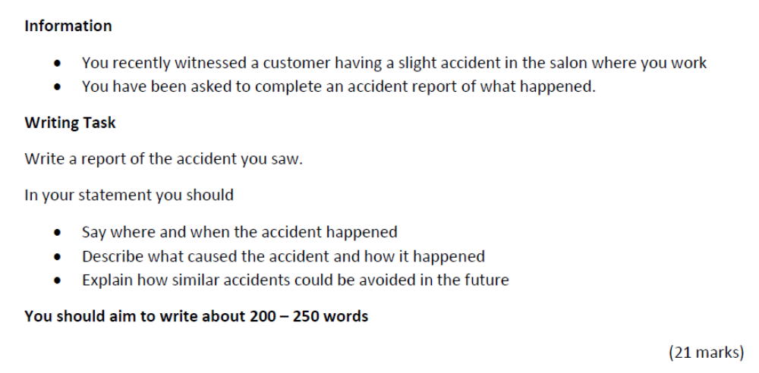
Pearson Accident Report Task

Slide 4
What Is an Accident Report?
Definition: An accident report is a formal written record of an accident or incident.
It explains:
• where and when the accident happened
• what happened and what caused it
• what happened immediately afterwards
• how similar accidents could be prevented
Remember: describe the accident factually, then give sensible recommendations based on what happened.

Slide 5
Purpose and Audience
Purpose
• to record exactly what happened
• to provide clear information for health and safety records
• to help prevent similar accidents in the future
Audience
• a manager, supervisor, employer, health and safety officer or insurance company
Language: formal, clear and factual.

Slide 6
Explaining the Layout/ Pearson Template
The Pearson writing frame is divided into these parts:
Your name and date: write the basic details clearly at the top.
Introduction: state where and when the accident happened.
Cause: explain what made the area or situation unsafe.
What happened: describe the events in time order using the past tense.
Prevention: give practical recommendations to stop it happening again.
Tip: Each paragraph should have a clear job.

Slide 7
Model Accident Report
Your Name: Aisha Khan
Date of Incident: 18 August 2026
The incident took place in the hair-washing area of Green Leaf Salon at approximately 2:30 pm on Monday 18 August 2026. I was working near the reception desk when I saw the accident happen.
A small amount of water had collected on the floor beside one of the washbasins. There was no warning sign in the area at the time. A customer was walking towards the washbasin when she stepped onto the wet floor. She lost her balance, slipped and fell onto her left side.
I immediately went to help the customer, and another member of staff brought her a chair. She said that her arm was slightly painful, but she did not appear to have a serious injury. The salon manager was informed about the incident straight away. The wet area was then cleaned and dried before any other customers were allowed to walk through it.
To prevent similar accidents in the future, staff should check the hair-washing area regularly and clean any water immediately. A warning sign should also be placed beside any wet area until the floor is completely dry. Staff should also receive regular reminders about health and safety procedures. These actions would reduce the risk of customers or staff slipping and help to keep the salon safer for everyone.
Word count: 214 words, excluding name and date.

Slide 8
Check Your SPaG and Task
SPaG Check
• Have I checked difficult spellings?
• Have I used capital letters and full stops?
• Have I used commas where needed?
• Have I used the past tense correctly?
• Have I written complete sentences?
Task Check
• Where did it happen?
• When did it happen?
• What caused the accident?
• How did it happen?
• How can future accidents be avoided?
• Is it about 200 to 250 words?

Slide 9
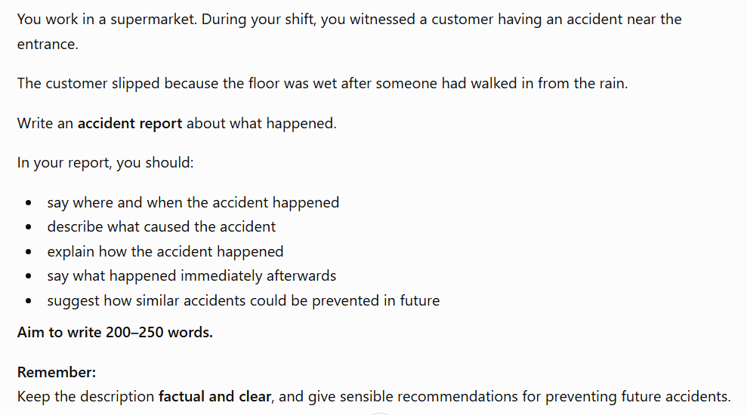
ACCIDENT REPORT – Class Practice

Slide 10
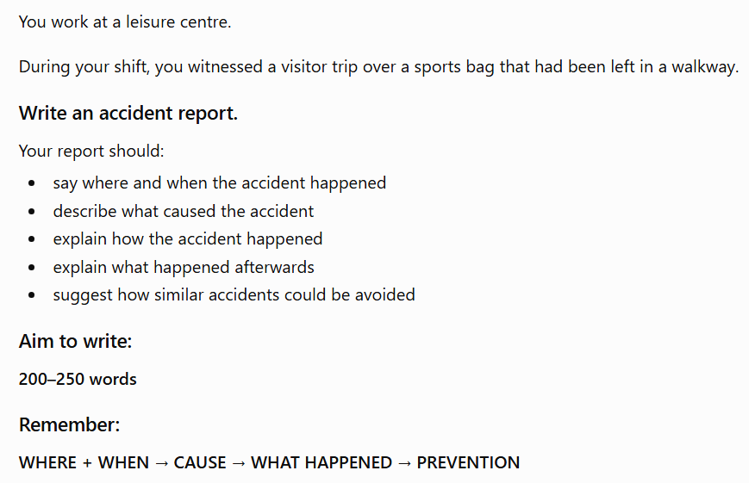
Homework – Accident Report

