Slide 1
Functional Skills English
Web Forum Writing
How to write a clear online contribution with your views

Slide 2
Session Aims
By the end of this lesson, you will be able to:
• understand what a web forum contribution is
• identify the purpose and audience of a web forum post
• understand the Pearson web forum template
• respond clearly to other people’s views
• give your own opinions with reasons and examples
• write a web forum contribution and check your SPaG

Slide 3
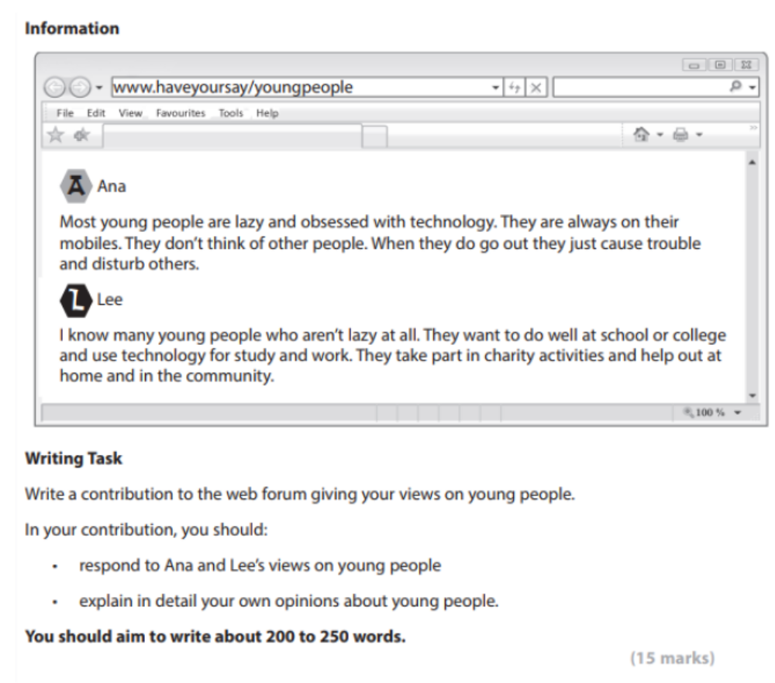
Pearson Web Forum Task

Slide 4
What Is a Web Forum Contribution?
Definition: A web forum contribution is a written post or reply in an online discussion.
People use web forums to share opinions, respond to others and give reasons for their views.
A good web forum contribution should:
• answer the question clearly
• respond to the views already given
• give your own opinion
• support your ideas with reasons and examples
• use suitable language for an online discussion

Slide 5
Purpose and Audience
Purpose
• to take part in an online discussion
• to respond to other people’s opinions
• to explain your own views clearly
• to persuade the reader with reasons and examples
Audience
• The audience is other people reading the web forum.
• The language can be friendly, but it should still be clear and respectful.

Slide 6
Pearson Web Forum Template
The Pearson writing frame is divided into these parts:
• Your name
• Your email address
• Respond to Ana’s views
• Respond to Lee’s views
• Explain in detail your own opinions about young people
Use paragraphs to organise your response clearly.

Slide 7
Explaining the Layout
Your name: write your name clearly.
Your email address: write a suitable email address if the task asks for one.
Respond to the first person: say if you agree, disagree or partly agree, and explain why.
Respond to the second person: comment on their view and add your reason.
Your own opinion: give your view in detail with examples.
Ending: finish with a clear final opinion or summary.

Slide 8
Useful Web Forum Language
Useful phrases:
• I agree with...
• I partly agree because...
• I understand this point, but...
• In my opinion...
• For example...
• Another important point is...
• Overall, I believe that...
Make sure your tone is respectful, even when you disagree.

Slide 9
Model Web Forum Contribution
Your name: Samira Ali
Your email address: samira.ali@example.com
I partly understand Ana’s point because some young people do spend too much time on their phones. For example, they may scroll through social media instead of speaking to people face to face. However, I think it is unfair to say that most young people are lazy and cause trouble. Many young people use technology for homework, job searches and staying in touch with family.
I agree more with Lee because I know many young people who work hard at school, college or work. Some also help at home by looking after younger brothers or sisters. Others volunteer, play sport or support charities in their community. These positive things are not always shown in the news, so people often get the wrong impression.
In my opinion, young people are not all the same. Some make poor choices, but adults do this too. Young people need encouragement, good role models and opportunities to succeed. I believe they can make a very useful contribution to society when they are trusted and supported.
Overall, I think young people should be judged fairly. Instead of blaming them, communities should listen to them and give them chances to show what they can do. This would help build better understanding between different age groups.
Word count: 208 words.

Slide 10
Check Your SPaG and Structure
Before you finish, check:
• Have I responded to both people’s views?
• Have I clearly given my own opinion?
• Have I explained my reasons in detail?
• Have I used examples where possible?
• Have I organised my writing into paragraphs?
• Have I used full stops, commas and capital letters correctly?
• Have I checked spelling and grammar?
• Have I written about 200 to 250 words?

Slide 11
Class Practice – Web Forum Writing
A college web forum is discussing homework.
Maya says students get too much homework and need more time to relax.
David says homework is important because it helps students practise and prepare for exams.
Write a contribution to the web forum giving your views on homework.
In your contribution, you should:
• respond to Maya’s view
• respond to David’s view
• explain in detail your own opinions about homework
Aim to write 200 to 250 words.

Slide 12
Homework – Web Forum Writing
A community web forum is discussing free public transport for young people.
Alex says it is a good idea because it would help families and reduce car traffic.
Priya says it is a bad idea because it would be too expensive and buses are already crowded.
Write a contribution to the web forum giving your views.
In your contribution, you should:
• respond to Alex’s view
• respond to Priya’s view
• explain in detail your own opinion about free public transport for young people
Aim to write 200 to 250 words.

