Slide 1
Functional Skills English Level 1
Web Form Writing
How to complete a clear, polite and well-structured web form

Slide 2
Session Aims
By the end of this lesson, you will be able to:
• understand what a web form is
• identify the purpose and audience of a web form
• understand the Pearson web form template
• describe problems clearly and in detail
• explain how the problems affect your life
• write a web form response and check your SPaG

Slide 3
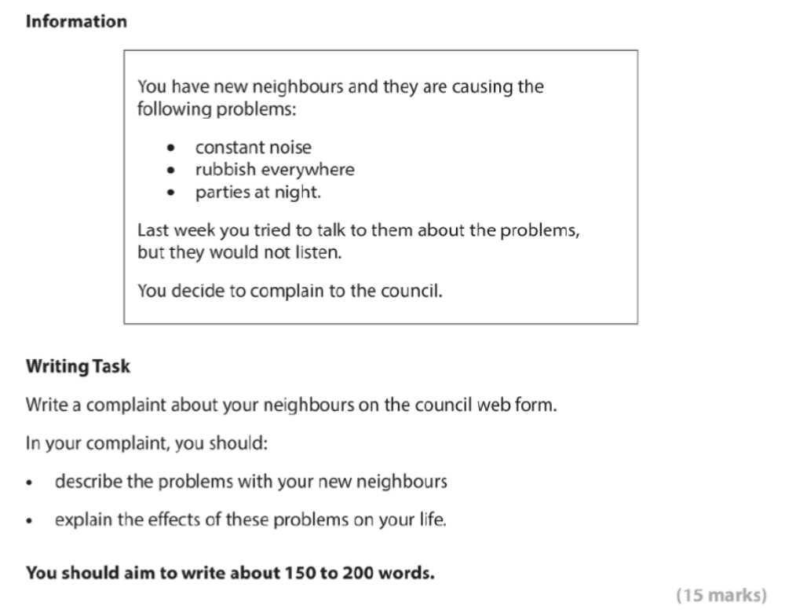
Pearson Web Form Task

Slide 4
What Is a Web Form?
Definition: A web form is an online form that people complete on a website.
You may use a web form to make a complaint, ask for help, give feedback or request information.
A good web form response should:
• answer the question clearly
• give important details
• use polite and suitable language
• stay focused on the task
• finish with a clear conclusion

Slide 5
Purpose and Audience
Purpose
• to explain a problem clearly
• to give important information and examples
• to explain how the problem affects you
• to ask for support, action or a response
Audience
• For this task, the audience is the council.
• The language should be polite, formal and easy to understand.

Slide 6
Pearson Web Form Template
The Pearson writing frame is divided into these parts:
• Your name
• Your email address
• Introductory paragraph
• Describe the problems with your new neighbours: noise, rubbish and parties
• Explain the effects of these issues on your life
• Conclusion

Slide 7
Explaining the Layout
Your name: write your name clearly.
Your email address: write a suitable email address if the task asks for one.
Introduction: explain why you are completing the web form.
Problems: describe each problem clearly, such as noise, rubbish and parties.
Effects: explain how the problems affect your sleep, family, work or study.
Conclusion: politely say what action or support you would like.

Slide 8
Useful Web Form Language
Useful phrases:
• I am writing to complain about...
• The main problem is...
• This has been happening for...
• This is affecting me because...
• As a result, I am unable to...
• I would be grateful if...
• Please could you look into this matter?
Keep your language clear, polite and formal.

Slide 9
Model Web Form Response
Your name: Samira Ali
Your email address: samira.ali@example.com
I am writing to complain about ongoing problems with new neighbours at 14 Oak Street, next to my home. The issues have continued for several weeks, even though I spoke to them politely last week.
The main problem is constant noise, especially loud music and shouting late at night. This often continues after midnight. There is also rubbish left outside their house and sometimes on the pavement, which looks untidy and attracts birds. In addition, they have parties at night, and visitors block driveways with their cars.
These problems are affecting my family’s daily life. I cannot sleep properly, so I feel tired at work. My children find it difficult to study in the evening because of the noise. The rubbish also makes the street unpleasant for residents and visitors.
I would be grateful if the council could contact the neighbours and remind them of their responsibilities. I would also like the area to be checked if the problems continue.
Word count: 160 words.

Slide 10
Check Your SPaG and Structure
Before you finish, check:
• Have I included my name and email address?
• Have I explained why I am completing the web form?
• Have I described the problems clearly?
• Have I explained how the problems affect my life?
• Have I included a polite conclusion?
• Have I used full stops, commas and capital letters correctly?
• Have I checked spelling and grammar?
• Have I written about 150 to 200 words?

Slide 11
Class Practice – Web Form Writing
You live near a local park. Recently, there have been problems in the park.
The problems are: broken benches, litter everywhere and teenagers making noise late in the evening.
Write a complaint on the council web form.
In your complaint, you should:
• describe the problems in the park
• explain how these problems affect local residents
• say what you would like the council to do
Aim to write 150 to 200 words.

Slide 12
Homework – Web Form Writing
Your street has problems with missed bin collections.
The bins have not been collected for two weeks, rubbish is building up and there is a bad smell.
Write a complaint on the council web form.
In your complaint, you should:
• describe the problems with the missed bin collections
• explain how these problems affect you and your neighbours
• say what action you would like the council to take
Aim to write 150 to 200 words.

