Slide 1
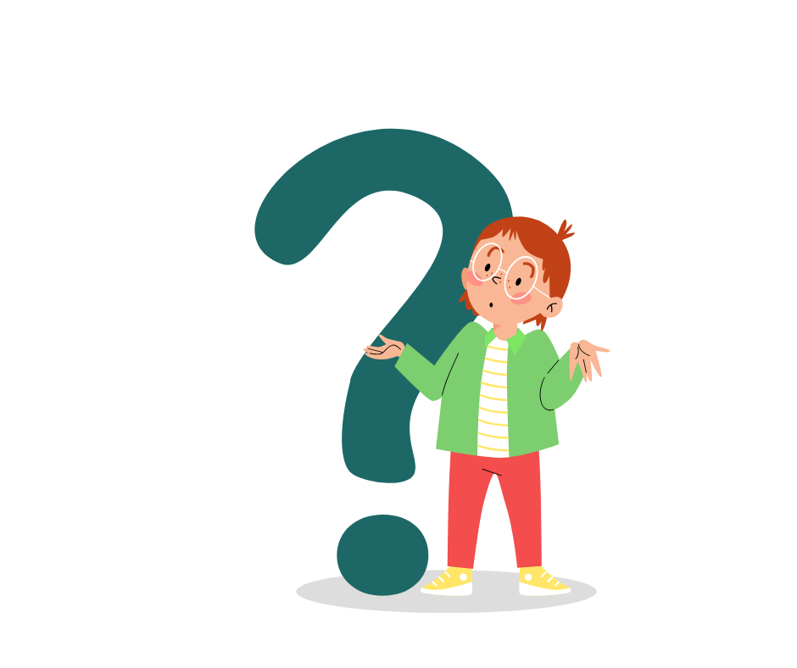
FUNCTIONAL SKILLS ENGLISH ENTRY 3
Text Purpose
Functional Skills English Entry 3 | Reading Skills
Today’s focus
Read smarter. Answer exam questions with confidence.
Text Purpose | 1/16

Slide 2
Today’s lesson
By the end of the session, you will be able to...
Reading skill
Identify the main purpose of everyday texts.
Exam skill
Choose the best answer and give a reason.
Life skill
Understand notices, adverts, emails and instructions.
Success criteria
• Understand what “text purpose” means.
• Recognise common purposes: inform, instruct, persuade, warn, advise and describe.
• Use clues from words, layout, pictures and what the reader is expected to do.
• Practise Entry 3-style questions using short everyday texts.
Text Purpose | 2/16

Slide 3
Why do people write things?
Every text is written for a reason.
Think about it
Why do people write...
• a bus timetable?
• a sale advert?
• a recipe?
• a warning sign?
Key idea
A writer has a reason.
That reason is the purpose.
Text Purpose | 3/16

Slide 4
What is text purpose?
The purpose is the reason why a text is written.
Text purpose = why
The purpose is the reason why a text is written.
In the exam
You may be asked:
“What is the main purpose of this text?”
Choose the best answer and use clues.
Purpose is NOT the topic
Topic: what the text is about
Purpose: why the writer wrote it
Example
Topic: bread offer
Purpose: to persuade people to buy bread
Text Purpose | 4/16

Slide 5
The main purposes we will practise
Entry 3 texts are usually everyday and practical.
To inform
give facts or information
To instruct
tell someone how to do something
To persuade
encourage someone to do/buy/believe
To warn
tell someone about danger or risk
To advise
give suggestions or recommendations
To describe
give details about a person, place or thing
Remember
One text can sometimes have more than one purpose.
Choose the MAIN purpose.
Text Purpose | 5/16

Slide 6
How to spot the purpose
Be a purpose detective: look for clues.
1. Words
Special offer, buy now, steps, warning, opening times...
2. Layout
Headings, bullet points, numbered steps, timetable, advert box...
3. Pictures
What does the picture suggest? Danger? Product? Journey?
4. Reader action
What does the writer want the reader to do or know?
Exam strategy
Read the title and first line. Ask: “What is the writer trying to do?” Then look for evidence.
Text Purpose | 6/16

Slide 7
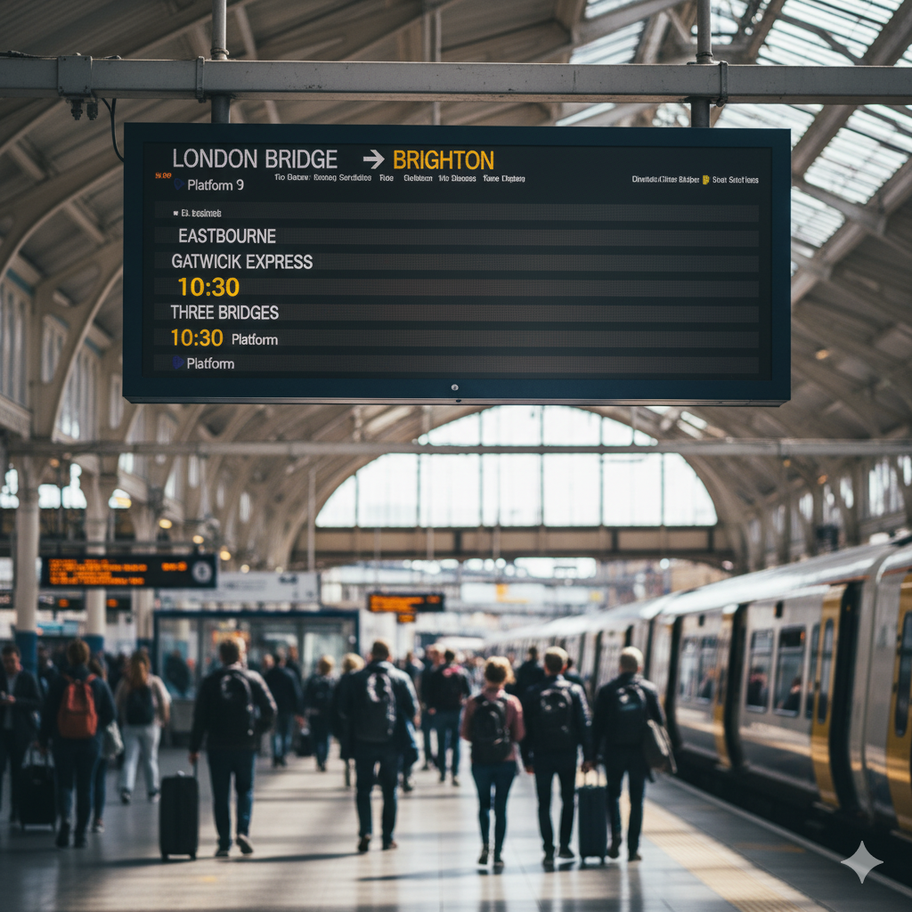
Purpose: to inform
The writer gives facts or useful information.
Purpose
To inform
Clues
• gives facts, dates, times or places
• does not try to sell something
• helps the reader know information
• examples: timetable, notice, opening hours
Exam clue
Look for factual details: time, date, place, price, contact number.
Text Purpose | 7/16

Slide 8
Purpose: to instruct
The writer tells the reader what to do or how to do it.
How to reset your password
1. Go to the login page.
2. Click “Forgotten password”.
3. Enter your email address.
4. Check your email.
5. Type a new password.
Purpose
To instruct
Clues
• gives steps in order
• uses command verbs: go, click, enter, check
• often uses numbers or bullet points
• reader needs to do something
Quick check
Is the text telling me HOW to do something?
Text Purpose | 8/16

Slide 9

Purpose: to persuade
The writer tries to make the reader do, buy or believe something.
Purpose
To persuade
Clues
• special offer / limited time
• positive words: best, fresh, free, easy
• tells the reader to visit, buy, join or try
• may use exclamation marks and bright images
Exam clue
Ask: Is the writer trying to change my mind or make me do something?
Text Purpose | 9/16

Slide 10
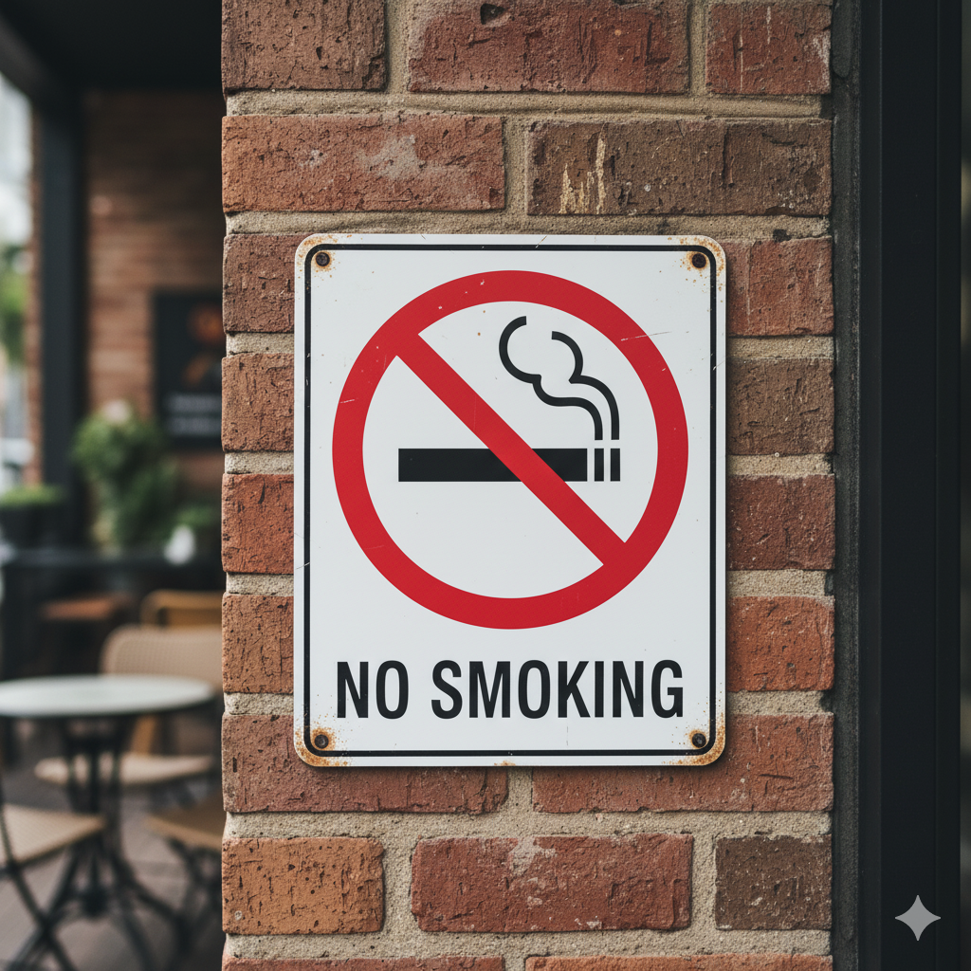
Purpose: to warn or advise
The writer tells the reader about danger or gives helpful guidance.
Purpose
To warn / advise
Clues
• warn: danger, risk or safety rule
• advise: helpful suggestion or recommendation
• uses words such as warning, caution, do not, should, remember
• helps the reader stay safe or make a good choice
Important
A “No Smoking” sign can inform people of a rule and warn them not to smoke.
Text Purpose | 10/16

Slide 11

Other purposes you may see
Some texts describe, express feelings or entertain.
To express
share feelings or thoughts
Example: birthday card / diary
To describe
give details about a person, place or thing
Example: review / travel writing
To entertain
make the reader enjoy it
Example: story, cartoon, joke
For Entry 3 exams
Focus most on the main purpose. Use evidence from the text.
Remember: choose the best answer for the whole text, not just one word.
Text Purpose | 11/16

Slide 12
Exam-style practice 1
Read the text. What is its main purpose?
Special Offer – Fresh Bakery
This week only! Buy any two loaves of bread and get a free pack of butter. Offer ends Sunday 10th August. Visit us at 12 High Street.
What is the main purpose of this text?
A. To inform
B. To persuade
C. To warn
D. To describe
Purpose clues
special offer • buy • free • visit us • this week only
Text Purpose | 12/16

Slide 13
Exam-style practice 2
Look for the key information and purpose.
Bus Timetable Change
From Monday 11 August, the number 12 bus will leave the station at 8.15 am instead of 8.00 am. The evening bus will still leave at 5.30 pm. Sorry for any inconvenience.
What is the main purpose of this text?
A. To instruct
B. To entertain
C. To inform
D. To persuade
Purpose clues
From Monday • bus will leave • 8.15 am • still leave at 5.30 pm
Text Purpose | 13/16

Slide 14
Exam-style practice 3
Watch for step-by-step instructions.
How to Reset Your Password
Go to the login page.
Click “Forgotten password”.
Enter your email address.
Check your email for the reset link.
Click the link and type a new password.
What is the main purpose of this text?
A. To warn
B. To instruct
C. To describe
D. To express
Purpose clues
numbered steps • command verbs • tells the reader how to do something
Text Purpose | 14/16

Slide 15
Purpose Detective: partner activity
Read. Decide. Prove your answer.
Step 1
Read each short text.
Step 2
Choose the main purpose.
Step 3
Underline two clues.
Step 4
Explain your answer to a partner.
Sentence starters
I think the purpose is to...
My clue is...
The writer wants the reader to...
This is not to persuade because...
Use the worksheet: Text Purpose Practice
Text Purpose | 15/16

Slide 16
Plenary: Did you get it?
Quick check and homework.
Exit ticket
1. What does text purpose mean?
2. Name two clues that help you identify purpose.
3. What is the purpose of a sale advert?
Homework
Find 3 real texts at home or online.
For each one, write:
• what the text is
• its main purpose
• one clue that proves it
Optional game
Baamboozle: Text Purpose
https://www.baamboozle.com/game/3710550
Text Purpose | 16/16

