Slide 1

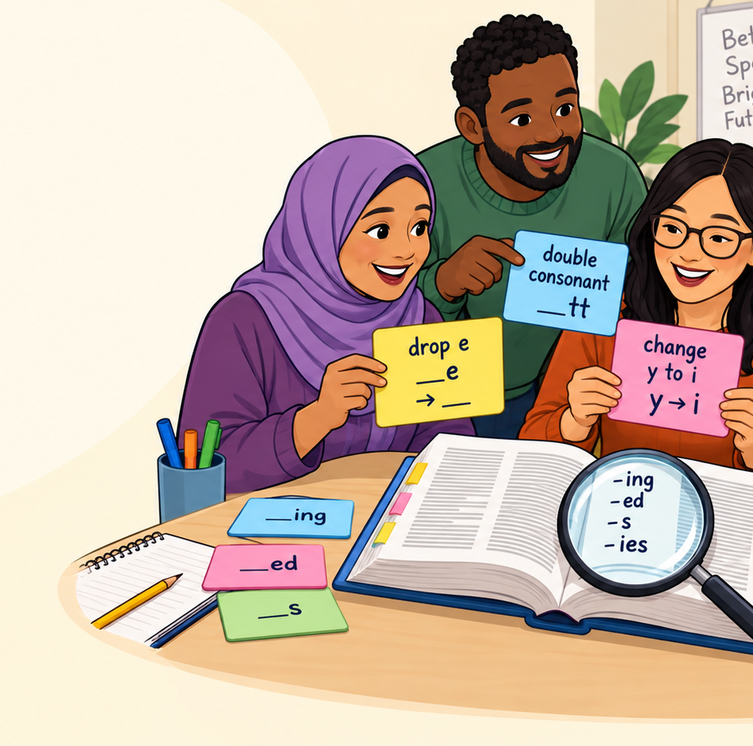
FUNCTIONAL SKILLS ENGLISH ENTRY 3
Spelling Rules
Writing Skills | Easy rules with examples
Today’s focus
Learn simple spelling rules and use them in writing.
Exam link
Entry 3 Writing includes a spelling task and written answers.
Spelling Rules | 1/16

Slide 2
Today's lesson
Simple spelling rules to help with Entry 3 writing and spelling tasks.
Learn
Understand common spelling rules.
Practise
Apply rules to everyday words.
Check
Proofread and correct spelling mistakes.
By the end of the lesson, you will be able to:
• use 5 common spelling rules
• choose the correct spelling in quick-test questions
• explain why a spelling changes
• proofread short sentences and fix mistakes
• create a personal spelling list for practice
I need to improve my spelling because clear writing helps the reader.
Spelling Rules | 2/16

Slide 3
Why spelling matters
Spelling affects your meaning and your marks.
In the Writing exam
You may need to spell ten words correctly and write clear answers using accurate spelling, punctuation and grammar.
In real life
Good spelling helps with emails, forms, job applications, messages, reports and classroom work.
Important reminder
Spelling rules help, but English has exceptions. When you are learning, keep a personal spelling list and practise little and often.
clear spelling → clear meaning
Reader understands your message.
Spelling Rules | 3/16

Slide 4
Strategy: Look, Say, Cover, Write, Check
Use this routine for difficult words.
1. Look
Look carefully at the word shape and tricky part.
2. Say
Say the word slowly and clearly.
3. Cover
Cover the word so you cannot copy it.
4. Write
Write the word from memory.
5. Check
Check and fix it.
Try it with these Entry 3 words:
receive → receive
Say: re-ceive
dictionary → dictionary
dic-tion-ar-y
separate → separate
sep-a-rate
because → because
big elephants can always understand small elephants
Your turn
Choose one word from your personal spelling list and practise it using the 5 steps.
Spelling Rules | 4/16

Slide 5
Rule 1: Add -s or -es
Most plurals use -s. Some need -es.
Most words: add -s
book → books
phone → phones
learner → learners
Words ending in s, sh, ch, x: add -es
bus → buses
box → boxes
watch → watches
Why?
We add -es when the word is hard to say with only -s.
Try saying: boxs ✗ → boxes ✓
dish → dishes
add -es
church → churches
add -es
form → forms
add -s
Spelling Rules | 5/16

Slide 6
Rule 2: Change y to i
For many words ending in consonant + y.
Consonant + y
Change y to i and add -es or -ed.
city → cities
baby → babies
try → tried
Vowel + y
Keep y and add -s or -ed.
key → keys
play → played
day → days
A vowel is: a, e, i, o, u.
Look at the letter before y.
family → families
l + y → ies
journey → journeys
e + y → ys
study → studied
d + y → ied
Spelling Rules | 6/16

Slide 7
Rule 3: Drop final e before -ing
When adding -ing, many words lose the final e.
Drop final e before -ing
make → making
write → writing
come → coming
Why?
If we keep the e, the word looks wrong:
writeing ✗ writing ✓
Important examples
use → using
drop e
move → moving
drop e
receive → receiving
drop e
Careful
Do not drop e when adding -ly: definite → definitely.
Spelling Rules | 7/16

Slide 8
Rule 4: Double the final consonant
Use this for short words with one vowel and one final consonant.
Short word pattern
one short vowel + one final consonant
stop → stopped / stopping
plan → planned / planning
Do not double every word
open → opened
visit → visited
listen → listening
This rule is useful, but not every word follows it. Check common exam words carefully.
rub → rubbing
double b
travel → travelled
double l in British English
happen → happened
do not double n
Spelling Rules | 8/16

Slide 9
Rule 5: Watch silent letters
Some letters are written but not strongly spoken.
Silent letters
Some words include letters that you write but do not hear clearly. Look carefully, practise often, and use word families when possible.
knife → k is silent
also: knee, knowledge
debt → b is silent
also: doubt
listen → t is silent
also: fasten
island → s is silent
remember: island
Memory tip
Circle the silent letter in your spelling list: k n i f e, d e b t, l i s t e n.
Spelling Rules | 9/16

Slide 10
Rule 6: Homophones
Same sound, different spelling and meaning.
there
place
Put the book over there.
their
belongs to them
Their class starts at 12:30.
they’re
they are
They’re working hard.
to
direction or infinitive
I went to class.
too
also / more than needed
I want to come too.
two
number 2
I have two pens.
Check the meaning before you choose the spelling.
Spelling Rules | 10/16

Slide 11
Rule 7: Break longer words into parts
Use syllables, word families and small chunks.
Break the word into chunks
com-mu-ni-cate
ed-u-ca-tion
ex-plain / ex-pla-na-tion
Look for word families
describe → description
explain → explanation
receive → receiving
Personal spelling list
Keep 5-10 tricky words from your writing. Practise them every week using Look, Say, Cover, Write, Check.
qualification → qual-i-fi-ca-tion
break it into sounds and parts
Spelling Rules | 11/16

Slide 12
Quick test 1: plurals
Choose the correct spelling.
Choose the correct spelling.
1
boxs / boxes
2
familys / families
3
churchs / churches
4
keys / keies
Think first
Ask: Does the word need -s, -es or y → ies?
Answers
1 boxes | 2 families | 3 churches | 4 keys
Spelling Rules | 12/16

Slide 13
Quick test 2: suffixes
What happens when we add -ing, -ed or -es?
Choose the correct spelling.
1
writeing / writing
2
stoped / stopped
3
useing / using
4
planned / planed
Think first
Ask: Do I drop e? Do I double the final consonant?
Answers
1 writing | 2 stopped | 3 using | 4 planned
Spelling Rules | 13/16

Slide 14
Quick test 3: proofread the sentence
Find and correct common spelling mistakes.
Sentence 1
They are receiveing there certificates next week.
Sentence 2
The familys were planing a trip to the musuem.
Correct answers
They are receiving their certificates next week.
The families were planning a trip to the museum.
Spelling Rules | 14/16

Slide 15
Exam-style spelling practice
Practise the 10-word spelling-task routine.
Teacher says
1. receive
2. dictionary
3. explanation
4. different
5. knowledge
6. particular
7. definite
8. medicine
9. believe
10. communicate
Learner does
Listen carefully.
Write the word.
Check the tricky part.
Correct one mistake if needed.
Practise again later.
Top tip
Do not only copy words.
Say them, cover them, write them, then check them.
Use your worksheet for the full 10-word spelling practice.
Spelling Rules | 15/16

Slide 16
Plenary: Did you get it?
Review the rules and choose one spelling target.
One rule I remember
s/es, y→ies, drop e, double consonant, silent letters
One word I can spell
Choose one Entry 3 word and say the tricky part.
One target
Choose 5 personal spelling words for this week.
Exit ticket
Correct this: “I am writeing a mesage about my familys holiday.”
Answer
I am writing a message about my family’s holiday.
Spelling Rules | 16/16

