Slide 1
Functional Skills English Entry 3
REVIEW WRITING

Slide 2
Session Aims
By the end of this session, learners will be able to:
Understand what a review is and why people write them
Write a clear and suitable title for a review
Follow the correct layout for an Entry 3 review
Include what it was about, who was in it, likes and dislikes with reasons
Write at least 8 sentences, including at least 3 compound sentences
Use at least 2 paragraphs

Slide 3
Warm-up
Talk first. Then write one quick answer.
Starter task
Example A
• Look at the two examples.
• Which one is clearer? Why?
• What details help the reader?
• What tone is best for this reader?
It is good.
Example B
I recommend this film because the story is exciting and easy to follow.
Online Review Writing • Entry 3 • 2/12

Slide 4
“Last Thing I Watched or Played”
Think about the last film, TV programme or video game you watched or played.
Tell your partner:
What was it called?
Did you like it? Why or why not?
Would you recommend it to a friend?
Be ready to share one interesting point with the class.

Slide 5
What is an online review?
Simple explanation for Entry 3 learners
Definition
Purpose
Audience
An online review gives information and opinion about something, such as a film, game, place, product or service.
• describe what it is
• say what you liked
• say what you disliked
• recommend or not recommend
• online readers
• other customers
• learners
• people choosing something
Purpose + audience + tone = better writing.
Online Review Writing • Entry 3 • 4/12

Slide 6
Exam requirements
Use this as your checklist in the writing exam.
Must include
Success criteria
• 8+ sentences
• 3+ compound sentences
• 2+ paragraphs
• clear recommendation
• answer every bullet point
• use the correct layout
• write in a logical order
• check spelling, punctuation and grammar
Do not start writing until you know exactly what the question asks you to include.
Online Review Writing • Entry 3 • 5/12

Slide 7
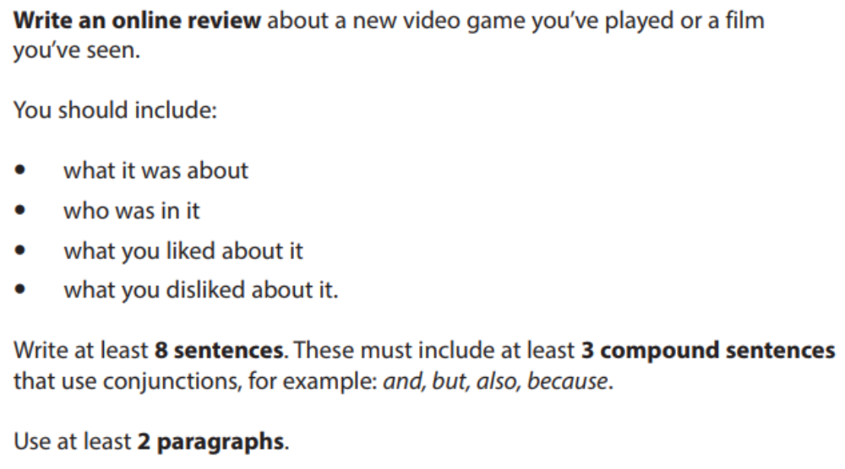
Exam Rules
At least 8 sentences (aim for 10)
At least 3 compound sentences (use and, but, because, so, or)
At least 2 paragraphs

Slide 8
LAYOUT OF A REVIEW
(According to the Pearson template)
1. Title
Short and clear (4–8 words)
Include the word “Review”
Tell the reader exactly what you are reviewing
Good examples:
Review of The Lion King
Review of FIFA 25
Samsung Galaxy Phone Review

Slide 9
LAYOUT OF A REVIEW
(According to the Pearson template)
2. Paragraph 1 – Introduction (The Facts)
What was the film / game called?
What was it about?
Who was in it? (actors or main characters)

Slide 10
LAYOUT OF A REVIEW
(According to the Pearson template)
3. Paragraph 2 – Your Opinions
What did you like about it and why?
What did you dislike about it and why? (Use However to move from positive to negative)

Slide 11
LAYOUT OF A REVIEW
(According to the Pearson template)
4. Conclusion
Would you recommend it?
Who would enjoy it?

Slide 12
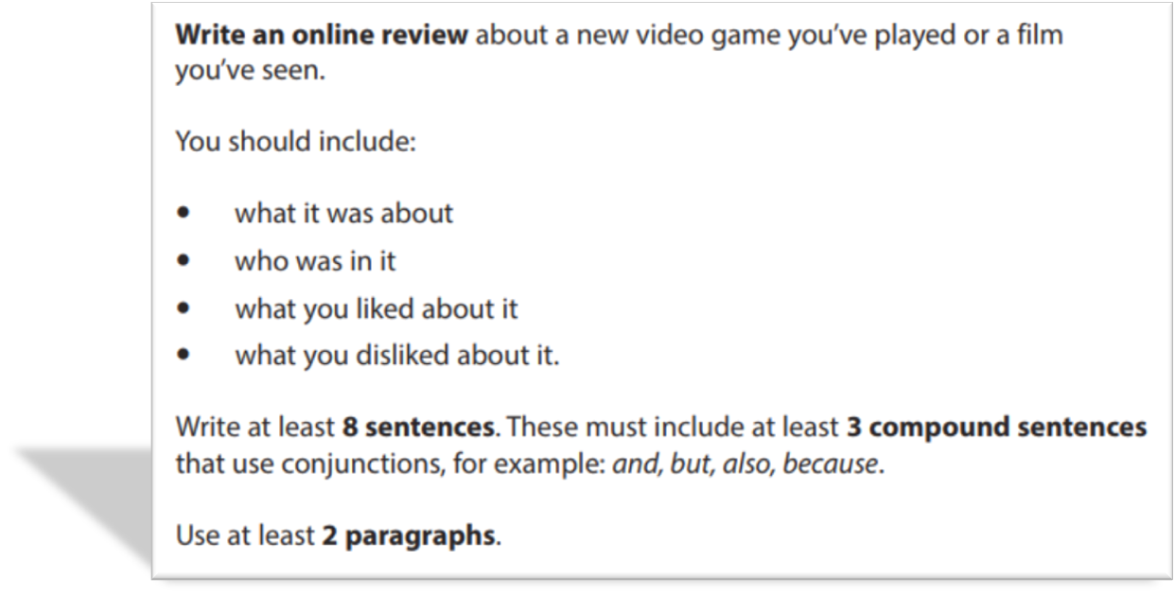
EXAM QUESTION AND SAMPLE ANSWER

Slide 13
Sample Answer: Review of The Lion King
Review of The Lion King
Last weekend I watched the new film called The Lion King. It is about a young lion called Simba who becomes the king of the jungle after his father dies. The main voices in the film are Beyoncé and Donald Glover. The story follows Simba as he grows up and learns to be brave.
I really liked the beautiful animation because the colours were bright and the animals looked real. The songs were also emotional and powerful and I enjoyed listening to them. The story was interesting and exciting from the beginning to the end. However, I didn’t like some parts because they were a bit slow and long. I also found the cinema very busy and I had to wait before the film started.
Overall, I enjoyed the film very much. I would recommend it to everyone, especially families with children, because it is suitable for all ages. I think most people will like this film.

Slide 14
Final check and plenary
Check your answer before you hand it in.
Content
Accuracy
Layout
• Did I answer all bullets?
• Did I add enough detail?
• Is the order logical?
• Capital letters?
• Full stops?
• Correct tense?
• Spelling checked?
• Right format?
• Paragraphs or bullets?
• Good opening and ending?
Exit question: What is one thing you will remember in the exam?
Online Review Writing • Entry 3 • 12/12

Slide 15
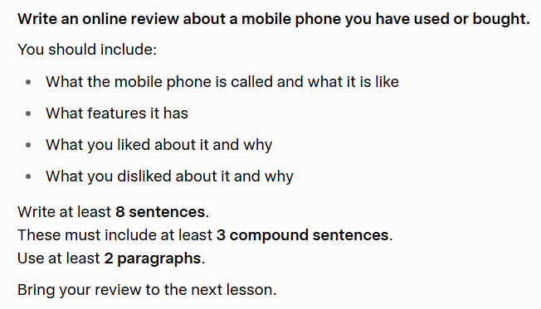
HOMEWORK

