Slide 1
Functional Skills English Level 1
Review Writing
How to write a clear, detailed and well-structured review

Slide 2
Session Aims
By the end of this lesson, you will be able to:
• understand the purpose of a review
• identify the main features of review writing
• understand the Pearson review template
• describe a place, product or service clearly
• give opinions with reasons and examples
• write a review and check your SPaG

Slide 3
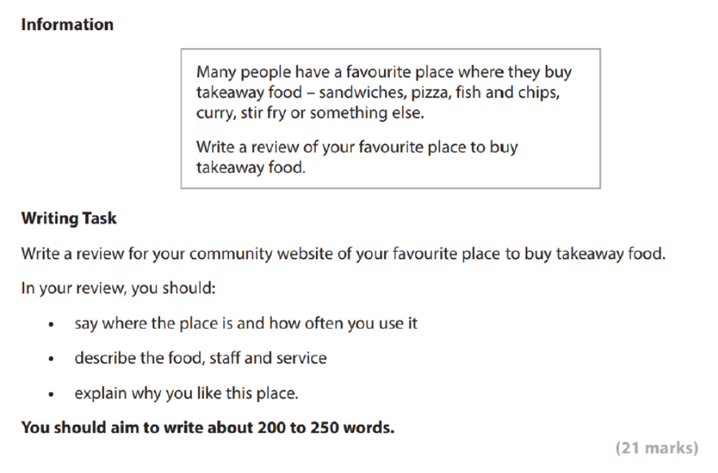
Pearson Review Writing Task

Slide 4
What Is a Review?
Definition: A review is a piece of writing that describes something and gives your opinion about it.
You may write a review about a place, service, product, film, book, restaurant or event.
A good review should:
• give clear information
• describe important details
• include your opinion
• explain your reasons
• help the reader decide what they think

Slide 5
Purpose and Audience
Purpose
• to inform readers about something
• to describe positive and/or negative points
• to give your opinion with reasons
• to recommend or not recommend something
Audience
• For this task, the review is for a community website.
• The language should be clear, polite and suitable for public readers.

Slide 6
Pearson Review Template
The Pearson writing frame is divided into these parts:
• Headline / Title
• Introductory paragraph: What is the place called? Where is it? How often do you use it?
• Describe the food
• Describe the staff and service
• Explain why you like this place
• Conclusion

Slide 7
Explaining the Layout
Headline / Title: make it clear and interesting.
Introduction: name the place, say where it is and how often you use it.
Food: describe quality, taste, price, choice and portion size.
Staff and service: describe how staff behave and how quickly customers are served.
Opinion and reasons: explain why you like or dislike the place.
Conclusion: finish with a recommendation or final opinion.

Slide 8
Useful Review Language
Useful phrases:
• My favourite place to buy takeaway food is...
• It is located...
• I usually go there...
• The food is...
• The staff are...
• The service is...
• I would recommend this place because...
Use describing words such as fresh, tasty, polite, helpful, quick, clean, expensive or good value.

Slide 9
Model Review
Green Grill Takeaway: A Local Favourite
My favourite place to buy takeaway food is Green Grill, which is on High Road near the library. I usually go there once or twice a month, especially when my family wants a quick meal at the weekend.
The food is fresh, tasty and good value for money. My favourite dish is the grilled chicken wrap because it is warm, filling and full of flavour. They also sell burgers, rice boxes and chips, so there is something for everyone. The portions are generous, and the food is always packed neatly, which makes the meal easy to carry home.
The staff are polite and helpful. They speak clearly, answer questions about the menu and serve customers quite quickly, even when the shop is busy. The service feels organised because the orders are taken carefully and the waiting time is usually short.
I like Green Grill because the food is reliable and the place is clean. It is also close to my home, so it is convenient when I do not have time to cook. Overall, I would recommend Green Grill to people in the local area because it offers tasty food, friendly service and fair prices.
Word count: 201 words.

Slide 10
Check Your SPaG and Structure
Before you finish, check:
• Have I written a clear title?
• Have I said where the place is and how often I use it?
• Have I described the food?
• Have I described the staff and service?
• Have I given my opinion and reasons?
• Have I included a conclusion?
• Have I checked spelling, punctuation and grammar?
• Have I written about 200 to 250 words?

Slide 11
Class Practice – Review Writing
Your community website wants reviews of local places where people can spend free time.
Write a review of a local park, library, leisure centre or community centre.
In your review, you should:
• say where the place is and how often you use it
• describe what people can do there
• describe the facilities, staff or atmosphere
• explain why you like or dislike this place
• finish with a recommendation
Aim to write 200 to 250 words.

Slide 12
Homework – Review Writing
A college website is asking learners to review useful learning resources.
Write a review of a website, app, book or video channel that helps you learn English.
In your review, you should:
• say what the resource is and how often you use it
• describe what it helps you learn
• explain what is good about it
• mention anything that could be improved
• say whether you would recommend it to other learners
Aim to write 200 to 250 words.

