Slide 1

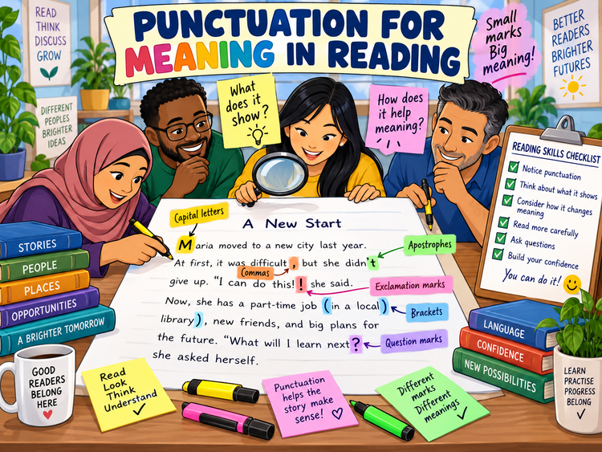
PUNCTUATION FOR
MEANING IN READING
Functional Skills English Level 1 Reading
Lesson focus:
How do small marks
change meaning?
Notice the mark • Think about its purpose • Explain the meaning
Punctuation for Meaning in Reading
Functional Skills English Level 1

Slide 2
Session aims
By the end of the lesson, you will be able to:
• explain how punctuation helps readers understand meaning
• identify the purpose of common punctuation marks in a text
• use evidence from a text to explain your answer
• answer Level 1 Reading questions about punctuation more confidently
Key question:
“What does this punctuation mark help the reader understand?”
Exam habit:
Do not just name the mark.
Explain what it does in the sentence.
Punctuation for Meaning in Reading
Functional Skills English Level 1

Slide 3
Warm-up: punctuation changes meaning
Look at the pairs. How does the punctuation change how you read the sentence?
You are coming.
You are coming?
Let’s eat, Grandma.
Let’s eat Grandma.
I can do this.
I can do this!
Pair talk: Which mark helped you understand the writer’s meaning?
Punctuation for Meaning in Reading
Functional Skills English Level 1

Slide 4
Why punctuation matters in Reading
In Level 1 Reading, you may be asked how punctuation helps the reader understand a text. This is different from simply adding punctuation in Writing.
Punctuation can show:
• where a sentence starts and ends
• extra information
• a list of items or ideas
• ownership or missing letters
• a question, surprise, warning or strong feeling
Exam answer frame:
• The punctuation mark is...
• It helps the reader understand...
• For example, in the text it shows...
• This is useful because...
Punctuation for Meaning in Reading
Functional Skills English Level 1

Slide 5
Capital letters: names and important words
Capital letters help readers identify names, places, organisations, days, months and important proper nouns.
They can help the reader spot:
• a person: Maria Khan
• a place: London Road Library
• a day or month: Monday / September
• an organisation: Redbridge Council
In Reading, explain:
• what the capital letter names
• why that word is important
• how it helps you find specific information quickly
Punctuation for Meaning in Reading
Functional Skills English Level 1

Slide 6
Commas: lists and pauses
Commas help separate information so the sentence is easier to understand. They often separate items in a list, extra details, or clauses.
Example 1: The centre offers English, maths, digital skills and childcare courses.
The commas separate the courses in a list.
Example 2: After the interview, applicants will receive an email.
The comma separates the opening time phrase from the main information.
Punctuation for Meaning in Reading
Functional Skills English Level 1

Slide 7
Apostrophes: ownership and missing letters
Apostrophe for possession
Apostrophe for omission
Possession:
• the learner’s book = the book belongs to one learner
• the parents’ meeting = the meeting is for parents
• shows who something belongs to or is connected with
Omission:
• don’t = do not
• we’re = we are
• can’t = cannot
• helps the writer use a shorter, often more informal style
Exam tip: say whether the apostrophe shows possession or missing letters.
Punctuation for Meaning in Reading
Functional Skills English Level 1

Slide 8
Brackets: extra information
Brackets add extra information. The sentence still makes sense if the bracketed information is removed.
Example:
The course starts on Monday (after the half-term break) and finishes in July.
What do the brackets do?
• add extra detail about the date
• help the reader understand timing
• keep the extra information separate from the main sentence
Answer frame:
• The brackets add extra information about...
• This helps the reader because...
Punctuation for Meaning in Reading
Functional Skills English Level 1

Slide 9
Question marks and exclamation marks
QUESTION MARK (?)
EXCLAMATION MARK (!)
Question marks:
• show the writer is asking something
• can involve the reader directly
• may make the text feel conversational
Exclamation marks:
• show strong feeling, excitement, warning or surprise
• can make a text sound lively or urgent
• may be common in adverts or informal texts
Ask: What feeling or effect does this mark create?
Punctuation for Meaning in Reading
Functional Skills English Level 1

Slide 10
Quotation marks: exact words
Quotation marks show exact words spoken or written by someone. They help readers separate a person’s words from the rest of the text.
Example:
“I finally feel confident using the bus,” said Ahmed.
They help the reader understand:
• the exact words Ahmed said
• that this is direct speech or a quotation
• the writer is using someone’s view as evidence
Level 1 link:
• quotation marks can help you find evidence quickly
• they may show a personal opinion in a text
Punctuation for Meaning in Reading
Functional Skills English Level 1

Slide 11
Class reading: spot the punctuation
Text: A New Start
Maria moved to a new city last year. At first, it was difficult, but she didn’t give up. “I can do this!” she said. Now, she has a part-time job (in a local library), new friends, and big plans for the future. What will I learn next? she asked herself.
Your task:
• underline one apostrophe
• circle one comma
• box the brackets
• explain one punctuation mark in a full sentence
Punctuation for Meaning in Reading
Functional Skills English Level 1

Slide 12
Answer check: explain the meaning
Possible explanations:
• The apostrophe in “didn’t” shows missing letters from “did not”.
• The exclamation mark in “I can do this!” shows strong feeling and confidence.
• The brackets add extra information about where Maria works.
• The question mark shows Maria is asking herself a question.
Strong answer:
“The brackets add extra information about Maria’s job. They tell the reader she works in a local library, but this is not the main point of the sentence.”
Weak answer:
“There are brackets.”
✘ This names the mark but does not explain meaning.
Punctuation for Meaning in Reading
Functional Skills English Level 1

Slide 13
Level 1 exam-style practice
Question 1: What does the apostrophe in “didn’t” show?
Question 2: How do the brackets help the reader understand the sentence?
Question 3: Why has the writer used an exclamation mark after “I can do this”?
Question 4: How does the question mark change the meaning at the end?
Answer in full sentences and explain the effect on meaning.
Punctuation for Meaning in Reading
Functional Skills English Level 1

Slide 14
Common mistakes to avoid
Do not:
• only name the punctuation mark
• ignore the sentence around it
• say “it makes it better” without explaining how
• forget to mention meaning, feeling or extra information
Do:
• read the whole sentence
• identify the punctuation mark
• explain what it helps the reader understand
• use words from the text as evidence
Punctuation for Meaning in Reading
Functional Skills English Level 1

Slide 15
Mini recap and next step
Commas can separate items or ideas.
Apostrophes can show possession or missing letters.
Brackets add extra information.
Question and exclamation marks show tone and meaning.
Now complete the worksheet and check your answers with the separate answer key.
Punctuation for Meaning in Reading
Functional Skills English Level 1

