Slide 1

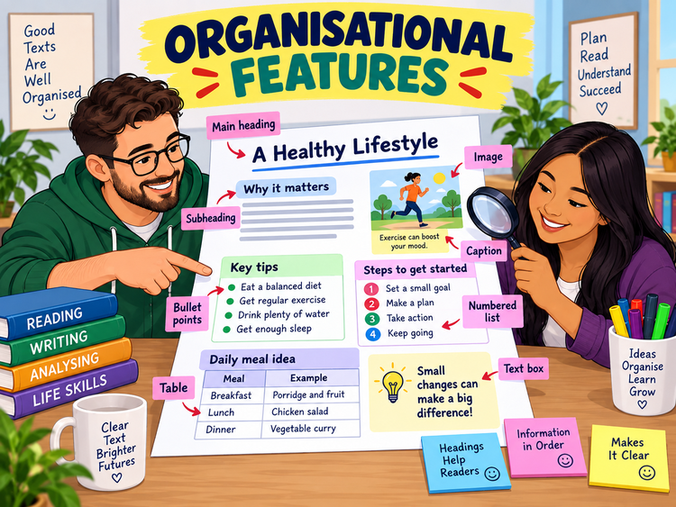
ORGANISATIONAL
FEATURES
Functional Skills English Level 1 Reading
Lesson focus:
How do layout features help readers find and understand information?
Find it faster • Explain the feature • Use evidence
Organisational Features
Functional Skills English Level 1

Slide 2
Session aims
By the end of the lesson, you will be able to:
• name common organisational features in Level 1 texts
• explain how features help the reader locate information
• identify features in webpages, articles, leaflets and notices
• answer Pearson-style questions using evidence from the text
Key question:
“How does the layout help the reader?”
Exam habit:
Name the feature, then explain what it helps the reader do.
Organisational Features
Functional Skills English Level 1

Slide 3
Warm-up: what helps you find information?
Look at a webpage or leaflet. Which feature would help you find each item quickly?
the price of a course
the main topic of a section
a list of steps to follow
information in rows and columns
extra important information
the meaning of a picture
Pair talk: What feature would you use first?
Organisational Features
Functional Skills English Level 1

Slide 4
What are organisational features?
Organisational features are the parts of a text that help arrange information clearly. They help readers find, follow and understand information.
Examples include:
• titles, headings and subheadings
• paragraphs and sections
• bullet points and numbered lists
• tables, images, captions and text boxes
They help readers to:
• see what the text is about
• locate specific information quickly
• follow the order of ideas
• notice important or extra details
Organisational Features
Functional Skills English Level 1

Slide 5
Headings and subheadings
A heading gives the main topic of a text or section. A subheading tells you what a smaller section is about.
Why they help:
• show the topic before you read the detail
• split a long text into clear sections
• help readers scan for relevant information
• make revision and exam reading faster
Example:
Heading: Healthy Lifestyle
Subheading: Why exercise matters
The subheading tells you where to find information about exercise.
Organisational Features
Functional Skills English Level 1

Slide 6
Bullet points and numbered lists
Bullet points:
• show separate points clearly
• make information quick to read
• often list choices, reasons or tips
• do not always show order
Numbered lists:
• show steps in order
• help readers follow instructions
• make a process easier to complete
• are useful for recipes, rules and guides
Exam tip: if the question asks for a process or order, check numbered lists first.
Organisational Features
Functional Skills English Level 1

Slide 7
Tables, images and captions
Tables:
• organise facts into rows and columns
• help compare information
• show times, prices, dates or results clearly
Images:
• attract attention
• support the meaning of the text
• may add information that is not written directly
Captions:
• explain an image
• name people, places or events
• help the reader understand why the image is included
Organisational Features
Functional Skills English Level 1

Slide 8
Text boxes, bold print and colour
Text boxes:
• make important or extra information stand out
• separate key details from the main text
• can contain warnings, tips or contact details
Bold print:
• highlights important words
• helps readers spot key terms
• draws attention to dates, rules or actions
Colour:
• groups related information
• makes headings and sections clear
• can guide the reader through the text
Organisational Features
Functional Skills English Level 1

Slide 9
What do Level 1 reading questions ask?
In Pearson-style Reading, you may need to:
• name an organisational feature used in a text
• explain how a feature helps the reader
• use a feature to locate relevant information
• compare how two texts organise information differently
Strong answer:
“The subheadings help the reader find different sections quickly, such as travel, costs and activities.”
Weak answer:
“It has subheadings.”
✘ This names the feature but does not explain how it helps the reader.
Organisational Features
Functional Skills English Level 1

Slide 10
Class reading: locate the information
Text: Healthy Lifestyle Day
Main heading: Healthy Lifestyle Day
Subheadings: Timetable | Food and Drink | Booking
Table: shows activity times and rooms
Text box: says “Book by Friday to get a free lunch.”
Image caption: “Learners try a five-minute fitness challenge.”
Your task:
• Which feature helps you find activity times?
• Which feature gives extra booking information?
• Which feature explains the image?
Organisational Features
Functional Skills English Level 1

Slide 11
Answer check: explain the feature
A table helps readers find activity times and rooms quickly because the information is arranged in rows and columns.
A text box makes the booking deadline stand out, so readers do not miss important extra information.
A caption explains the image and helps readers understand what the learners are doing.
Use this sentence frame: “The feature helps the reader to…”
Organisational Features
Functional Skills English Level 1

Slide 12
Level 1 exam-style practice
Question 1: Name one organisational feature used in the text.
Question 2: Which feature would help you find times quickly?
Question 3: Explain how the text box helps the reader.
Question 4: Explain why the writer has used subheadings.
Name the feature + explain how it helps the reader.
Organisational Features
Functional Skills English Level 1

Slide 13
Common mistakes to avoid
Do not:
• only name a feature without explaining it
• confuse a heading with a caption
• ignore images, tables or text boxes
• write a vague answer such as “it looks nice”
Do:
• say what the feature is
• say what information it helps locate
• explain how it helps the reader
• use evidence from the text when possible
Organisational Features
Functional Skills English Level 1

Slide 14
Mini recap and next step
Organisational features arrange information clearly.
They help readers find, follow and understand ideas.
Always explain how the feature helps the reader.
In the exam, use the exact feature name when you can.
Now complete the worksheet and check your answers with the separate answer key.
Organisational Features
Functional Skills English Level 1

