Slide 1

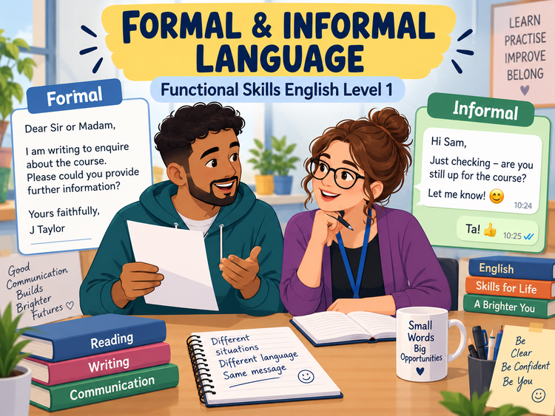
FORMAL & INFORMAL
LANGUAGE
Functional Skills English Level 1 Reading
Lesson focus:
How does language change
for audience and purpose?
Choose the right tone • Spot clues • Explain your answer
Formal and Informal Language
Functional Skills English Level 1

Slide 2
Session aims
By the end of the lesson, you will be able to:
• explain what formal and informal language means
• identify language features that show tone and register
• match language to audience and purpose
• answer Level 1 reading questions using evidence from a text
Key question:
“Who is writing, who is reading, and why?”
Exam habit:
Always quote a word or phrase
that proves your answer.
Formal and Informal Language
Functional Skills English Level 1

Slide 3
Warm-up: formal or informal?
Read each example. Decide if it is formal (F) or informal (I).
Dear Customer, your order is ready for collection.
Can you send me the details ASAP?
I would be grateful for a reply by Friday.
Cheers for helping me out yesterday!
Please arrive 10 minutes before your interview.
See you there – it should be fun!
Pair talk: What words helped you decide?
Formal and Informal Language
Functional Skills English Level 1

Slide 4
What do “formal” and “informal” mean?
Formal language is more careful, polite and professional. It is often used in workplaces, official documents and messages to people you do not know well.
Informal language is more relaxed and personal. It is often used with friends, family or people you know well.
Think about:
• audience – who will read it?
• purpose – why is it written?
• situation – official or personal?
• relationship – close or distant?
Key idea:
• The message may be similar, but the wording changes.
• Good readers notice tone and register, not just topic.
Formal and Informal Language
Functional Skills English Level 1

Slide 5
When do we use formal language?
Common situations:
• emails to a manager, college or company
• letters of complaint or enquiry
• reports, notices and official messages
• applications, interviews and customer service communication
Formal features:
• full words: “do not”, “cannot”
• polite phrases: “please”, “I would be grateful”
• clear sentences with fewer slang words
• often complete punctuation and accurate spelling
Example: “Please contact reception if you need further information.”
Formal and Informal Language
Functional Skills English Level 1

Slide 6
When do we use informal language?
Common situations:
• texts or chats with friends and family
• social messages to people you know well
• quick personal notes and casual comments
• friendly invitations and everyday conversation
Informal features:
• shorter, more relaxed wording
• contractions: “I’m”, “don’t”, “can’t”
• friendly tone, personal phrases and everyday vocabulary
• may include exclamation marks, emojis or chat-style language
Example: “Hi Sam, just checking if you’re free later.”
Formal and Informal Language
Functional Skills English Level 1

Slide 7
Formal vs informal: quick comparison
FORMAL
INFORMAL
Formal:
• Dear Sir or Madam
• I am writing to enquire about…
• Could you please…?
• Yours sincerely / faithfully
Informal:
• Hi / Hello
• Just wanted to ask about…
• Can you…?
• See you / Thanks / Bye
Level 1 tip: do not decide from one word alone – look at the whole text.
Formal and Informal Language
Functional Skills English Level 1

Slide 8
Useful word choices
Informal phrase
More formal version
Why it matters
thanks
thank you
more polite and professional
find out
obtain / learn
more precise
get back to me
reply to me
clearer for formal writing
kids
children
more appropriate in formal contexts
a lot of
many / a great deal of
more formal tone
Formal and Informal Language
Functional Skills English Level 1

Slide 9
What do Level 1 reading questions ask?
In Pearson-style reading, you may need to:
• identify whether a text is formal or informal
• quote a word or phrase that shows the tone
• explain why the language is suitable for the audience
• compare two texts with different purposes or styles
Strong answer:
“The language is formal because it uses polite phrases such as ‘I would be grateful’ and the greeting ‘Dear Customer’.”
Weak answer:
“It is formal because it sounds formal.”
✘ No evidence from the text.
Formal and Informal Language
Functional Skills English Level 1

Slide 10
Class reading: compare two short texts
Text A – email to a college
Text B – message to a friend
Dear Admissions Team,
I am writing to request information about your evening English course. Could you please tell me the start date and the course fee?
Yours sincerely,
M Patel
Hi Maya,
Do you know when the evening English class starts? I want to join. If you hear anything, let me know!
Thanks!
Discuss:
• Which text is formal?
• Which words show this?
• Who is each text written for?
Formal and Informal Language
Functional Skills English Level 1

Slide 11
Practice: change the register
Informal to formal:
“Can you send me the course dates?”
Possible formal version:
“Could you please send me the course dates?”
Informal to formal:
“Thanks for your help.”
Possible formal version:
“Thank you for your assistance.”
Your turn: rewrite one formal sentence as informal and one informal sentence as formal.
Formal and Informal Language
Functional Skills English Level 1

Slide 12
Level 1 exam-style practice
Question 1: Which text is more formal? Give one reason from the text.
Question 2: Copy one word or phrase from Text A that shows a formal tone.
Question 3: Explain why Text B is suitable for a friend.
Question 4: Which text would be better for contacting a college? Explain why.
Use evidence and mention audience or purpose in your answer.
Formal and Informal Language
Functional Skills English Level 1

Slide 13
Common mistakes to avoid
Do not:
• assume formal means difficult words only
• call a text informal just because it is short
• ignore the audience and purpose
• write “it sounds formal” without quoting evidence
Do:
• look at greetings and endings
• notice polite phrases and contractions
• look for slang, emojis or chat-style wording
• explain how the language suits the situation
Formal and Informal Language
Functional Skills English Level 1

Slide 14
Mini recap and next step
Formal language = careful, polite, professional.
Informal language = relaxed, personal, friendly.
Choose language to match audience and purpose.
In the exam, quote words that prove your answer.
Now complete the worksheet and check your answers with the separate answer key.
Formal and Informal Language
Functional Skills English Level 1

