Slide 1

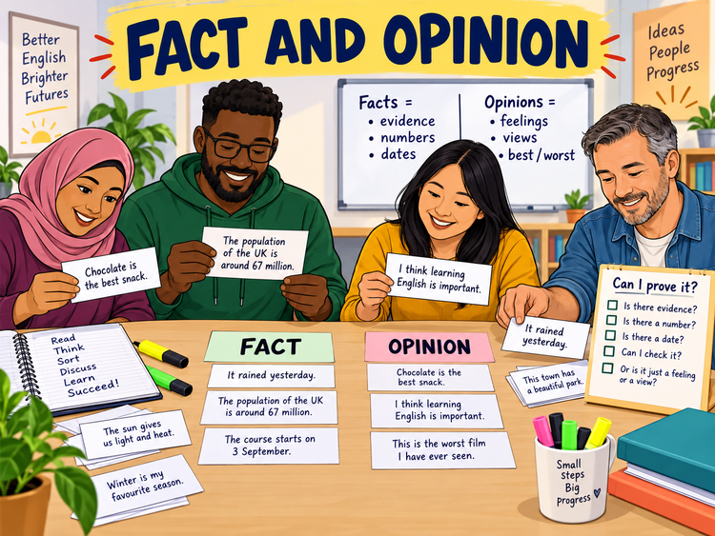
FACT AND OPINION
Functional Skills English Level 1 Reading
Lesson focus:
Can I prove it?
Or is it a view?
Read carefully • Find evidence • Explain your answer
Fact and Opinion
Functional Skills English Level 1

Slide 2
Session aims
By the end of the lesson, you will be able to:
• explain the difference between a fact and an opinion
• identify facts and opinions in Level 1 reading texts
• use clue words and evidence to justify your answer
• answer Pearson-style questions with more confidence
Key question:
“Can I prove or check this?”
Exam habit:
Do not guess.
Find evidence in the text.
Fact and Opinion
Functional Skills English Level 1

Slide 3
Warm-up: fact or opinion?
Read each sentence. Hold up F for fact or O for opinion.
The bus leaves at 8:15 am.
This bus route is the best.
The ticket costs £2.80.
The journey is too long.
The café has 12 tables.
The food is delicious.
Pair talk: How did you decide?
Fact and Opinion
Functional Skills English Level 1

Slide 4
What is a fact?
A fact is something that can be checked or proved. It is based on evidence, not personal feelings.
Facts often include:
• dates and times
• numbers, prices and measurements
• names of people or places
• information you can check
Examples:
• The course starts on 3 September.
• The website had 5,000 visitors in June.
• The meeting is in Room 4.
Fact and Opinion
Functional Skills English Level 1

Slide 5
What is an opinion?
An opinion is what someone thinks, feels or believes. It may sound strong, but it cannot be proved in the same way as a fact.
Opinion clue words:
• best, worst, better, nicer
• delicious, boring, excellent, terrible
• I think, I believe, in my view
• should, must, need to
Examples:
• This is the best course.
• The canteen food is delicious.
• Online lessons are better than classroom lessons.
Fact and Opinion
Functional Skills English Level 1

Slide 6
Fact vs opinion: quick comparison
FACT
OPINION
Fact:
• Can be checked or proved
• Uses evidence: dates, times, numbers, names
• Usually the same for everyone
• Example: “The club has 300 members.”
Opinion:
• Shows a view, feeling or judgement
• Uses words like best, worst, should, nice
• Can be different for different people
• Example: “The club is very popular.”
Level 1 tip: A fact can support an opinion. Look at how evidence is being used.
Fact and Opinion
Functional Skills English Level 1

Slide 7
What does Pearson-style reading ask you to do?
In Level 1 Reading, you may need to:
• identify a fact or an opinion
• copy a quotation that shows a view
• explain why a sentence is a fact or an opinion
• spot clue words and use evidence from the text
Good answer:
“This is an opinion because the word ‘best’ shows a judgement. Different readers may not agree.”
Weak answer:
“It is an opinion because I think so.”
✘ No evidence from the text.
Fact and Opinion
Functional Skills English Level 1

Slide 8
Clues that help you decide
Fact clues:
• a date, time or year
• a number, price or measurement
• a named place or person
• information that can be checked
Opinion clues:
• judgement words
• feeling words
• modal verbs such as should/must
• phrases such as I think / I believe
Remember: check the whole sentence, not just one word.
Fact and Opinion
Functional Skills English Level 1

Slide 9
Be careful: opinions can sound confident
“This is clearly the safest way to travel.”
It sounds strong, but it is still an opinion. “Safest” needs evidence.
“The train has CCTV in every carriage.”
This is a fact if it can be checked. It may support an opinion about safety.
Exam question habit: Ask “What words prove my answer?”
Fact and Opinion
Functional Skills English Level 1

Slide 10
Class reading: find the facts and opinions
Text: The New Community Food Club
A new community food club opened in Hill Road on 4 March. It is open every Tuesday and Thursday from 10 am to 2 pm. Members pay £3 each week and can choose up to ten food items. The club has 85 members and is supported by six volunteers. Local resident Amina says, “This club is the most helpful service in our area because it saves families money.” Another member believes the opening hours are too short, but most people said the staff were kind and welcoming.
Your task:
• underline two facts
• circle two opinions
• explain one answer using evidence
Fact and Opinion
Functional Skills English Level 1

Slide 11
Answer check: explain your thinking
Facts:
• opened in Hill Road on 4 March
• open Tuesday and Thursday, 10 am to 2 pm
• members pay £3 each week
• 85 members / six volunteers
Opinions:
• most helpful service in our area
• opening hours are too short
• staff were kind and welcoming
Say why: “This is a fact because…” / “This is an opinion because…”
Fact and Opinion
Functional Skills English Level 1

Slide 12
Level 1 exam-style practice
Question 1: Copy one sentence from the text that gives a fact about the food club.
Question 2: Which word or phrase shows that Amina is giving an opinion?
Question 3: Explain why “The club has 85 members” is a fact.
Question 4: Explain why “the opening hours are too short” is an opinion.
Answer in full sentences and use evidence from the text.
Fact and Opinion
Functional Skills English Level 1

Slide 13
Common mistakes to avoid
Do not:
• call something a fact just because you agree with it
• call something an opinion just because it is negative
• forget to use evidence from the text
• write a long answer when a short, clear one is enough
Do:
• look for checkable information
• look for judgement or feeling words
• copy short, exact evidence when needed
• explain your choice clearly
Fact and Opinion
Functional Skills English Level 1

Slide 14
Mini recap and next step
A fact can be checked or proved.
An opinion shows what someone thinks, feels or believes.
In the exam, use evidence from the text.
Ask: “Can I prove it?”
Now complete the worksheet. Check your answers using the separate answer key.
Fact and Opinion
Functional Skills English Level 1

