Slide 1

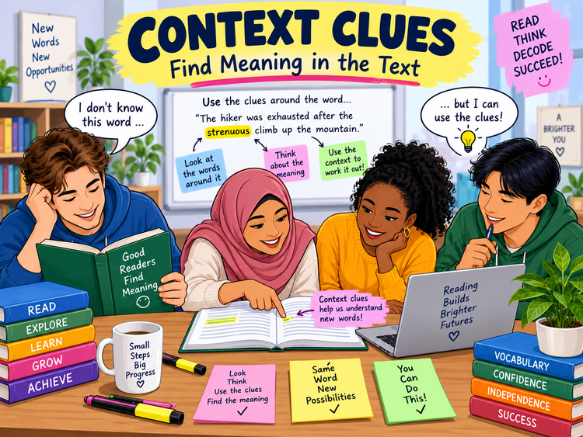
CONTEXT CLUES
Functional Skills English Level 1 Reading
Lesson focus:
Use the words around an unfamiliar word
to work out its meaning.
Read around the word • Test a meaning • Check it fits
Context Clues
Functional Skills English Level 1

Slide 2
Session aims
By the end of the lesson, you will be able to:
• use surrounding words and sentences to work out meaning
• recognise common types of context clue
• use word type to narrow down possible meanings
• choose an alternative word or phrase that keeps the meaning the same
• answer Level 1 exam-style vocabulary questions with evidence
Key question:
“What nearby words help me understand this word?”
Exam habit:
Replace the word with your answer.
Does the sentence still make sense?
Context Clues
Functional Skills English Level 1

Slide 3
Warm-up: can you work it out?
Read each sentence. Guess the bold word from the clues around it.
After walking for six hours, Amir was exhausted and needed to rest immediately.
Tickets were scarce; only a few were left by lunchtime.
Mina was reluctant to speak first, so she waited until someone else volunteered.
Pair talk: Which words gave you the clue?
Context Clues
Functional Skills English Level 1

Slide 4
What are context clues?
Context clues are words, phrases or sentences around an unfamiliar word that help you work out its meaning.
Good readers:
• read before and after the unfamiliar word
• look for explanations, examples or contrasts
• think about the word type: noun, verb, adjective or adverb
• try a possible meaning in the sentence
Example:
• “The route was strenuous, so we stopped twice to rest.”
• The clue “stopped twice to rest” suggests strenuous means difficult or tiring.
Context Clues
Functional Skills English Level 1

Slide 5
Five useful types of context clue
1. Definition / explanation: the text tells you what the word means.
2. Synonym / restatement: a nearby word gives a similar meaning.
3. Example clue: examples show what the word includes.
4. Contrast clue: words such as but, however, unlike or although show an opposite idea.
5. Cause / result clue: what happens before or after helps reveal the meaning.
You do not need to name the clue type in the exam - you need to use it well.
Context Clues
Functional Skills English Level 1

Slide 6
Word type matters
Noun - person, place, thing or idea
• salary = pay / earnings
• variety = range / choice
Verb - an action
• reduce = decrease / make less
• consider = think about
Adjective - describes a noun
• vital = essential / very important
• sizeable = large / considerable
Adverb - describes how / when / how much
• especially = particularly / mainly
• gradually = slowly over time
Context Clues
Functional Skills English Level 1

Slide 7
The substitution test
Step 1
Read the whole sentence and notice the unfamiliar word.
Step 2
Choose a possible synonym that matches the word type.
Step 3
Replace the original word with your synonym.
Step 4
Check: does the sentence keep the same meaning?
Example: “Saving regularly is vital.” vital → essential ✓ The meaning stays the same.
Context Clues
Functional Skills English Level 1

Slide 8
Pearson-style vocabulary: set 1
WORD
POSSIBLE SAME-MEANING WORDS
QUICK CHECK
vital
essential • crucial • important
Does it still mean necessary?
reduce
decrease • lower • make less
Is the amount becoming smaller?
top-class
excellent • outstanding • first-rate
Does it still mean very good?
focus
concentrate • target • aim
Does it fit the sentence grammar?
These are the types of “alternative word or phrase” questions you need to practise.
Context Clues
Functional Skills English Level 1

Slide 9
Pearson-style vocabulary: set 2
WORD
POSSIBLE SAME-MEANING WORDS
WORD TYPE
sizeable
large • substantial • considerable
adjective
consider
think about • examine • keep in mind
verb
salary
pay • wages • earnings
noun
especially
particularly • mainly • in particular
adverb
Exam tip: your answer must keep the meaning of the original sentence.
Context Clues
Functional Skills English Level 1

Slide 10
Class reading: decode the vocabulary
Text: The Community Repair Project
The new repair project is designed to make household items last longer. Volunteers with considerable experience will show residents how to mend small electrical items and furniture. Booking is essential because places are limited. The project hopes to reduce waste and make repairs more accessible to local families. People should consider bringing one item that is safe to carry.
Work out the meaning of:
• considerable
• essential
• reduce
• accessible
• consider
For each word:
• underline the clue
• write a synonym
• check it fits the sentence
Context Clues
Functional Skills English Level 1

Slide 11
Answer check: how did the context help?
considerable = a large amount of / substantial
essential = necessary / very important
reduce = decrease / make less
accessible = easy for people to use or obtain
consider = think about
Say the reason: “I chose ___ because the sentence shows…”
Context Clues
Functional Skills English Level 1

Slide 12
Level 1 exam-style practice
1. Give an alternative word or phrase for “scarce” that keeps the meaning the same.
2. In “The service is particularly useful for new learners”, give another word for “particularly”.
3. “The centre aims to promote healthy travel.” What could replace “promote”?
4. Explain which words in “The path was slippery, so walkers moved slowly” help you understand “slippery”.
Remember: meaning + grammar + context must all fit.
Context Clues
Functional Skills English Level 1

Slide 13
Common mistakes to avoid
Do not:
• guess from the unfamiliar word alone
• choose a synonym with the wrong word type
• use a word that changes the sentence meaning
• read only the same sentence when the clue may be nearby
Do:
• read one or two sentences around the word
• look for explanation, contrast, examples or results
• substitute your answer back into the sentence
• use a dictionary only when allowed and needed
Context Clues
Functional Skills English Level 1

Slide 14
Mini recap and next step
Context = the words and ideas around an unfamiliar word.
Clues can be definitions, synonyms, examples, contrasts or results.
Word type helps you choose a suitable meaning.
Use the substitution test: does your answer keep the meaning?
Now complete the Level 1 worksheet. Use the separate answer key to check afterwards.
Context Clues
Functional Skills English Level 1

