Slide 1

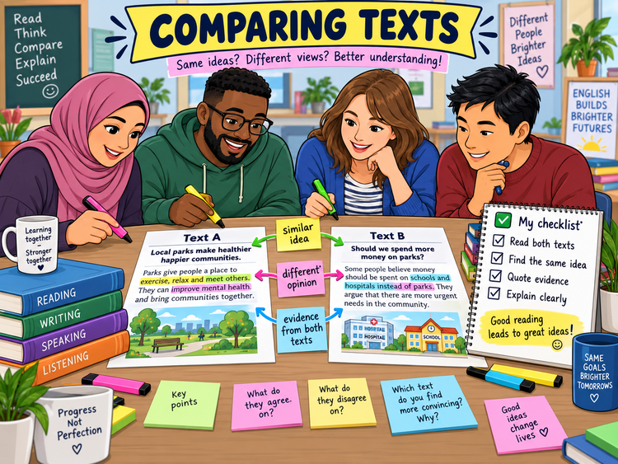
COMPARING TEXTS
Functional Skills English Level 1 Reading
Lesson focus:
What is the same?
What is different?
What evidence proves it?
Read both texts • Find evidence • Explain clearly
Comparing Texts
Functional Skills English Level 1

Slide 2
Session aims
By the end of the lesson, you will be able to:
• identify information, ideas and opinions in two texts
• find similarities and differences between texts
• select evidence from both texts
• write a clear Level 1 comparison answer
Key question:
“What do both texts say, and how are they different?”
Exam habit:
Use evidence from both texts. Do not only talk about one.
Comparing Texts
Functional Skills English Level 1

Slide 3
Warm-up: same or different?
Compare these two short messages. What is the same? What is different?
Text A: The local park is useful because people can exercise there. It also gives families a free place to relax.
Text B: The park is nice, but the council should spend more money on buses and street lights.
Pair talk:
• What do both texts mention?
• What does only Text A say?
• What does only Text B say?
Comparing Texts
Functional Skills English Level 1

Slide 4
What does comparing texts mean?
Comparing texts means looking at two texts together. You notice what is similar and what is different.
You compare:
• information - facts and details
• ideas - what the writer thinks is important
• opinions - views and attitudes
• language - formal, informal, persuasive or descriptive
You need to ask:
• What is the same in both texts?
• What is different?
• Which text gives stronger evidence?
• What words or phrases prove this?
Comparing Texts
Functional Skills English Level 1

Slide 5
Level 1 comparison questions
In the exam, you may be asked to:
• compare information in two texts
• identify a shared idea or opinion
• explain a difference between the texts
• quote evidence from Text A and Text B
Good answer:
“Both texts say the park helps people exercise. Text A says people can ‘exercise there’, and Text B says parks encourage ‘healthy habits’.”
Weak answer:
“They are both about parks.”
✘ Too general. No evidence from both texts.
Comparing Texts
Functional Skills English Level 1

Slide 6
A simple comparison method
1. Read both texts
2. Find the topic
3. Underline evidence
4. Decide: same or different?
5. Use both texts
6. Explain clearly
Sentence frame: Both texts say... Text A states... Text B also says... However, Text B is different because...
Comparing Texts
Functional Skills English Level 1

Slide 7
Useful comparison words
For similarities:
• both
• also
• similarly
• in the same way
• Text A and Text B both say...
For differences:
• however
• but
• whereas
• on the other hand
• Text A says..., while Text B says...
Level 1 tip: a comparison answer should not become two separate summaries.
Comparing Texts
Functional Skills English Level 1

Slide 8
Class reading: Text A and Text B
Text A: Why community gardens matter
Text B: Are gardens the best use of space?
Community gardens give people a place to grow fruit and vegetables. They help neighbours meet each other, and they can improve mental health. Volunteers say the gardens make streets look brighter and safer.
Some residents like community gardens, but others think more space should be used for parking. They argue that families need safe roads and enough parking near their homes. They still agree that green spaces can help people relax.
Task:
• highlight one shared idea
• underline one difference
• choose evidence from both texts
Comparing Texts
Functional Skills English Level 1

Slide 9
Answer check: what can we compare?
Similarity:
• Both texts say green spaces can help people.
• Text A says gardens “improve mental health”.
• Text B says green spaces “can help people relax”.
Difference:
• Text A is positive about community gardens.
• Text B gives a different view about parking.
• Text B says “more space should be used for parking”.
Now turn this into a full comparison answer.
Comparing Texts
Functional Skills English Level 1

Slide 10
How to write a comparison answer
Step 1: Start with the similarity.
“Both texts suggest that green spaces are useful for people.”
Step 2: Use evidence from Text A.
“Text A says gardens can ‘improve mental health’.”
Step 3: Use evidence from Text B.
“Text B also says green spaces ‘can help people relax’.”
Step 4: Add a difference if needed.
“However, Text B also argues that some space should be used for parking.”
Comparing Texts
Functional Skills English Level 1

Slide 11
Model answer
Both texts say that green spaces can help people. Text A says community gardens can “improve mental health”, and Text B says green spaces “can help people relax”. However, the texts are different because Text A is very positive about gardens, while Text B gives another view and says some space should be used for parking.
Why this is a strong answer:
• it compares the two texts
• it uses evidence from both texts
• it explains a similarity and a difference
• it uses linking words: both, and, however, while
Comparing Texts
Functional Skills English Level 1

Slide 12
Level 1 exam-style practice
Question 1: Give one idea that both texts share.
Question 2: Copy one phrase from Text A and one phrase from Text B that support this shared idea.
Question 3: Explain one difference between the two texts.
Question 4: Which text gives a more balanced view? Explain using evidence.
Use both texts. Quote short evidence. Explain clearly.
Comparing Texts
Functional Skills English Level 1

Slide 13
Common mistakes to avoid
Do not:
• write about only one text
• copy long sections without explaining
• say “they are the same” without evidence
• confuse the topic with the writer’s view
Do:
• read both texts carefully
• find evidence from both texts
• use comparison words
• explain the similarity or difference
Comparing Texts
Functional Skills English Level 1

Slide 14
Mini recap and next step
Compare = look at two texts together.
Use evidence from Text A and Text B.
Find similarities and differences.
Use words like both, also, however and whereas.
Now complete the worksheet and check your answers with the separate answer key.
Comparing Texts
Functional Skills English Level 1

