Slide 1
Functional Skills English Entry 3
INFORMAL LETTER WRITING

Slide 2
Session Aims
By the end of this session, learners will be able to:
Understand what an informal letter is
Start the letter correctly with “Dear + name”
Include all the required information from the question
Write at least 8 sentences, including at least 3 compound sentences
Use at least 2 paragraphs
End the letter with a friendly closing and first name

Slide 3
Warm-Up:“Tell Your Friend”
Imagine your friend is moving to your town. Tell your partner one thing:
Something fun to do in your town
Something you like about your town
Something you dislike about your town

Slide 4
What is an informal letter?
Simple explanation for Entry 3 learners
Definition
Purpose
Audience
An informal letter is a personal letter to a friend, relative or someone you know well. It is friendly but still needs clear sentences and paragraphs.
• share news
• describe an event
• invite someone
• thank someone
• friend
• relative
• classmate
• neighbour you know
Purpose + audience + tone = better writing.
Informal Letter Writing • Entry 3 • 4/12

Slide 5
Exam requirements
Use this as your checklist in the writing exam.
Must include
Success criteria
• 8+ sentences
• 3+ compound sentences
• 2+ paragraphs
• friendly greeting and ending
• answer every bullet point
• use the correct layout
• write in a logical order
• check spelling, punctuation and grammar
Do not start writing until you know exactly what the question asks you to include.
Informal Letter Writing • Entry 3 • 5/12

Slide 6
Layout (Exam Style)
In the Pearson exam, you usually start directly with the greeting.
Greeting → Dear Sam,
Opening → Friendly sentence (How are you?)
Paragraph 1 → Answer the first bullet points
Paragraph 2 → Answer the remaining bullet points
Closing → Best wishes, / See you soon, / Take care,
Your first name

Slide 7
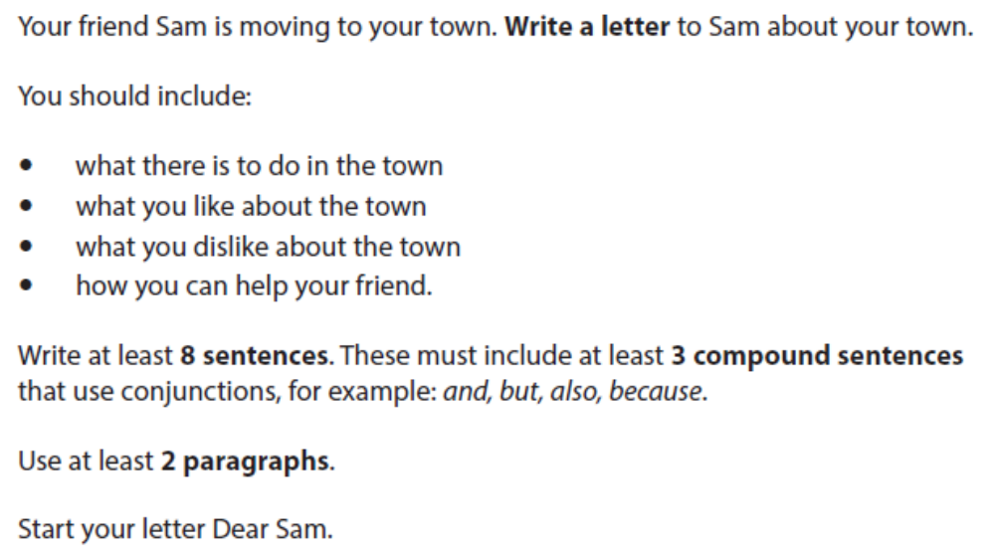
Exam Question
Exam Rules
At least 8 sentences
At least 3 compound sentences (and, but, also, because)
At least 2 paragraphs

Slide 8
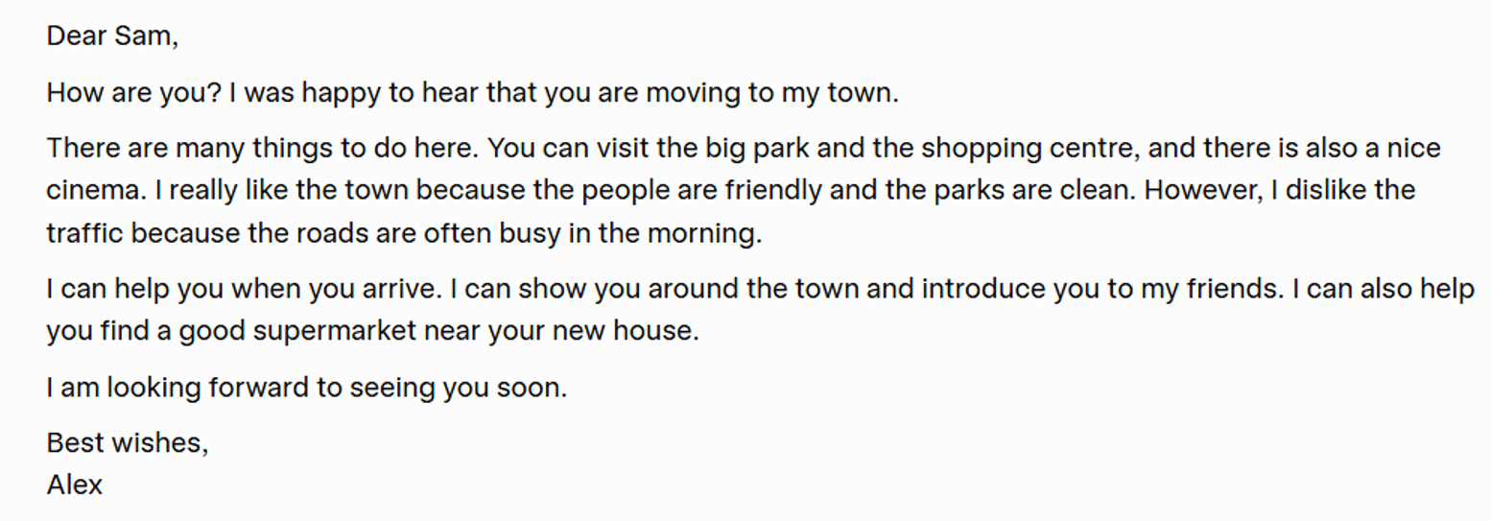
INFORMAL LETTER: SAMPLE ANSWER

Slide 9
Final check and plenary
Check your answer before you hand it in.
Content
Accuracy
Layout
• Did I answer all bullets?
• Did I add enough detail?
• Is the order logical?
• Capital letters?
• Full stops?
• Correct tense?
• Spelling checked?
• Right format?
• Paragraphs or bullets?
• Good opening and ending?
Exit question: What is one thing you will remember in the exam?
Informal Letter Writing • Entry 3 • 12/12

Slide 10
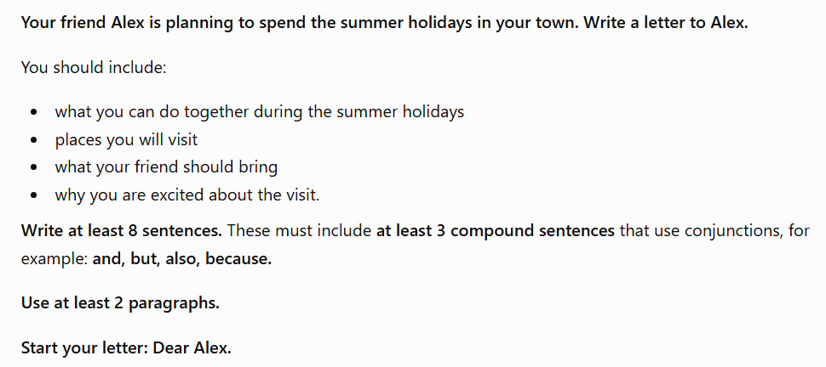
HOMEWORK

