Slide 1
Functional Skills English Level 1
Informal Email Writing
How to write a friendly, clear and well-organised informal email

Slide 2
Session Aims
By the end of this lesson, you will be able to:
• understand the purpose of an informal email
• identify the main features of informal email writing
• use a friendly but clear tone
• organise ideas into clear paragraphs
• include all the information from the task
• write and check an informal email

Slide 3
Informal Email Task
Example task:
Your friend Sam could not come to a community food festival with you last weekend.
Write an email to Sam about the festival.
In your email, you should:
• describe what happened at the festival
• explain what you enjoyed most
• invite Sam to come with you next time
Aim to write about 150 to 200 words.

Slide 4
What Is an Informal Email?
Definition: An informal email is a friendly message sent to someone you know well, such as a friend or family member.
An informal email should:
• have a clear email address and subject/title
• use a friendly greeting
• sound natural and polite
• give information clearly in paragraphs
• include your thoughts, feelings or opinions where needed
• end with a friendly closing

Slide 5
Purpose and Audience
Purpose
• to share news or information
• to describe an experience
• to invite, thank, apologise or explain something
Audience
• a friend, cousin, classmate or family member
• The tone can be friendly and personal, but the writing must still be clear.

Slide 6
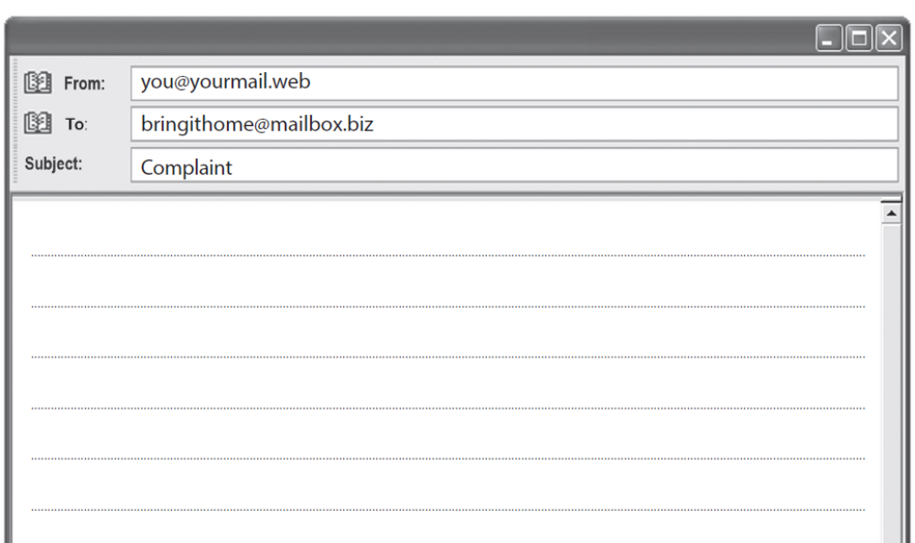
Very Important!
In the Pearson Level 1 Email Exam:
The From, To, and Subject lines are usually already filled in by the examiner.
You do not need to write them again.
You should start your email directly with the greeting/salutation.

Slide 7
Standard Email Layout (Template)
Email Structure (Always use this order)
Email Address (sender’s and receiver’s) (From & To)
Title of Email (Subject line)
Opening Greeting (Dear Mr/Ms …,)
Introductory Paragraph – Why you are writing
Main Body – Cover all bullet points from the question
Closing Paragraph – Polite ending + what you want
Closing Salutation (Yours sincerely, / Best regards,)
Your First Name Only
Always follow this layout. It helps you organise your email and get better marks.
Usually already filled in

Slide 8
Useful Informal Email Language
Useful sentence starters:
• I hope you are well.
• I wanted to tell you about...
• You would have loved it because...
• The best part was...
• I think you should come next time.
• Let me know what you think.
Friendly language is fine, but avoid text-message spellings like “u” or “gr8” in the exam.

Slide 9
Model Informal Email
Email address: sam786@example.com
Title of email: Food Festival
Hi Sam,
I hope you are well. I wanted to tell you about the community food festival I went to last weekend. I know you could not come, so I thought I would share what happened.
The festival was in the town centre, and it was busy but exciting. There were food stalls from many countries, live music and a small area where children could play. I tried some Turkish bread and a spicy chicken wrap. They were delicious and not too expensive.
The best part was the atmosphere. Everyone seemed relaxed and friendly, and the music made the place feel lively. I also met two people from my English class, which was a nice surprise. I took a few photos too.
You should definitely come with me next time. I think you would enjoy the food and the music. Maybe we can go together if they organise it again next month.
Speak soon,
Aisha
Word count: 155 words, excluding email address and title.

Slide 10
Check Your SPaG and Layout
Before you finish, check:
• Have I used a suitable email address?
• Have I included a clear title/subject?
• Have I used a friendly greeting and closing?
• Have I explained why I am writing?
• Have I answered all parts of the task?
• Have I used clear paragraphs?
• Have I checked spelling, punctuation and grammar?
• Have I written about 150 to 200 words?

Slide 11
Class Practice – Informal Email
You have started a new hobby or club and you are enjoying it.
Write an email to a friend about it.
In your email, you should:
• say what the hobby or club is
• describe what you do there
• explain why you enjoy it
• invite your friend to try it with you
Aim to write 150 to 200 words.

Slide 12
Homework – Informal Email
You recently visited a new shopping centre, park or restaurant.
Write an email to your cousin about your visit.
In your email, you should:
• say where you went and who you went with
• describe what you saw or did there
• explain what you liked or disliked
• suggest going there together another time
Aim to write 150 to 200 words.

