Slide 1
Functional Skills English Entry 3
INFORMAL EMAIL WRITING

Slide 2
Session Aims
By the end of this session, learners will be able to:
Understand the purpose of an informal email
Use the correct layout for an informal email
Write a friendly subject line
Use informal but correct language
Include bullet points when needed
Write 8+ sentences with at least 3 compound sentences

Slide 3
Warm-up
Discuss with a partner:
Who do you usually write informal emails or messages to? Why?

Slide 4
What is an Email?
A Digital Letter
Email stands for Electronic Mail. Think of it as sending a letter, but instead of using a pen, paper, and a stamp, you use a computer or phone.
Why do we use them?
  Fast: It arrives in seconds, not days.
  Free: You don't need to buy a stamp!
  Universal: You can send them to friends, family, or businesses anywhere in the world.
Just like a real letter, it still needs an address (email address) and a message inside!

Slide 5
What is an informal email?
Simple explanation for Entry 3 learners
Definition
Purpose
Audience
An informal email is a friendly message to someone you know, such as a friend, classmate or family member.
• invite someone
• thank someone
• share news
• give simple information
• friend
• classmate
• relative
• someone you know well
Purpose + audience + tone = better writing.
Informal Email Writing • Entry 3 • 4/12

Slide 6
Correct Layout (Informal Email)
To: (friend’s or family member’s name)
From: (your name)
Subject: (short and friendly)
Greeting: Dear + first name / Hi + first name
Introduction (friendly opening)
Main points (use bullet points if giving details)
Closing (Kind regards, / Best wishes,)
Your first name

Slide 7
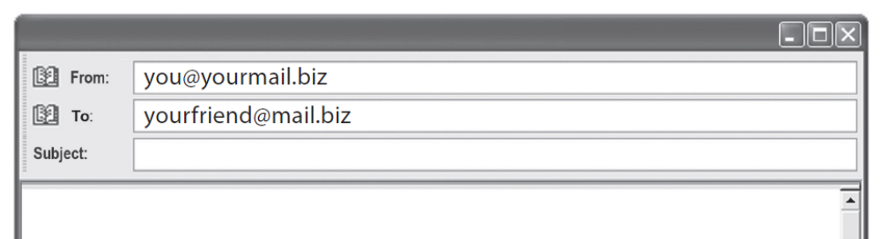
STRUCTURE OF AN EMAIL
Note:
In the Pearson Entry 3 exam, the To and From boxes are already given for you.
You only need to write the Subject the message, and the bullet points.

Slide 8
The Subject Line
The Subject Line = The Book Title
It tells the reader what the email is about before they open it.
Rule: Keep it short (3-6 words).
Examples:
❌ Bad: "Hello how are you I want to ask about the party." (Too long!)
✅ Good (Informal): Invitation to my party
✅ Good (Formal): Complaint about broken TV
✅ Good (Formal): Job Application

Slide 9
Informal Salutation (Greeting)
Use a friendly greeting:
Dear Sam,
Hi Sam,
Hello Sara,
Always put a comma after the name.

Slide 10
Informal Opening Sentence
Start in a friendly way:
How are you?
I hope you are well.
It was nice to hear from you.
I just wanted to tell you about…
Keep the tone friendly but correct.

Slide 11
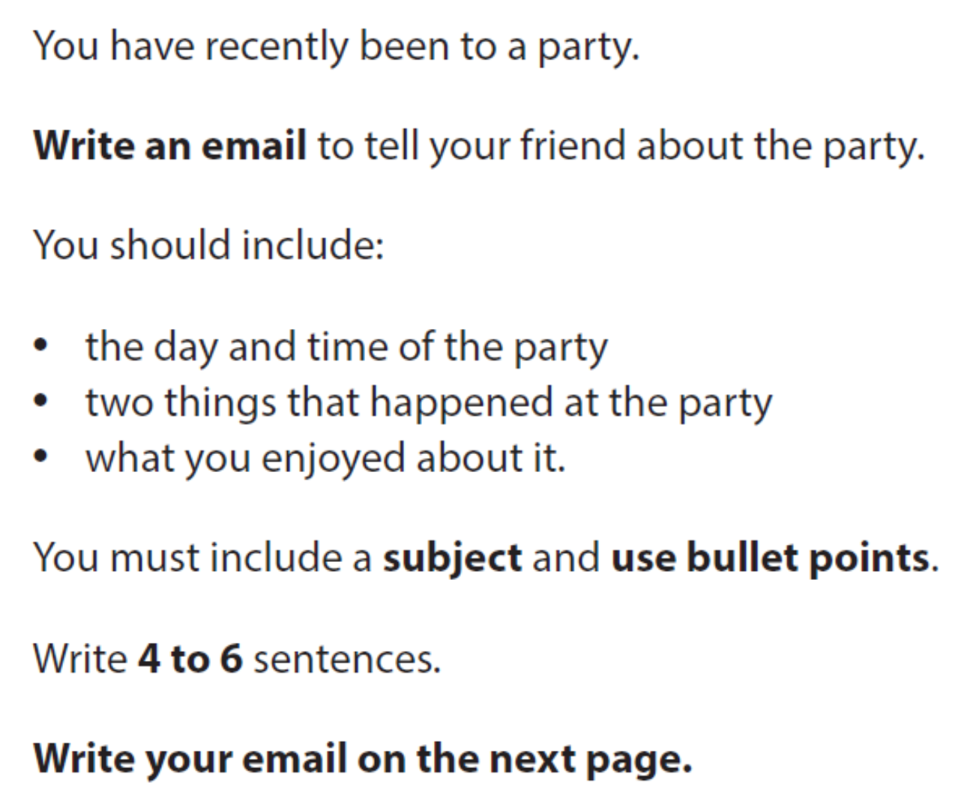
The Body (The Important Bit!)
The Shopping List Rule
Look at the Bullet Points in the exam question.
You MUST write one full sentence for every bullet point.
Don't skip any items on the list!

Slide 12
INFORMAL CLOSING (GOODBYE)
End your email in a friendly way:
Kind regards,
Best wishes,
Take care,
See you soon,
Then write your first name.

Slide 13
USEFUL LANGUAGE
How are you?
I hope you are well.
Guess what?
Let me know…
Kind regards, / Best wishes,

Slide 14

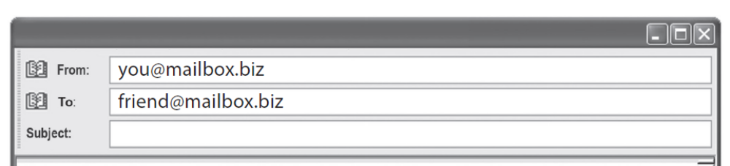
EXAM STYLE QUESTION

Slide 15
Sample Email Answer
Subject: The party last Saturday
Hi Sara,
I went to a really nice party last Saturday. I had a great time and I want to tell you all about it. It was good to see so many friends again.
Here are the details:
• The party was on Saturday at 7 o’clock in the evening.
• First, we played some games in the garden.
• Later, everyone danced in the living room.
• I really enjoyed the music and the delicious chocolate cake.
I felt very happy at the party. I hope we can go to another party together soon. Please write back and tell me your news.
Best wishes,
Alex

Slide 16
Final check and plenary
Check your answer before you hand it in.
Content
Accuracy
Layout
• Did I answer all bullets?
• Did I add enough detail?
• Is the order logical?
• Capital letters?
• Full stops?
• Correct tense?
• Spelling checked?
• Right format?
• Paragraphs or bullets?
• Good opening and ending?
Exit question: What is one thing you will remember in the exam?
Informal Email Writing • Entry 3 • 12/12

Slide 17
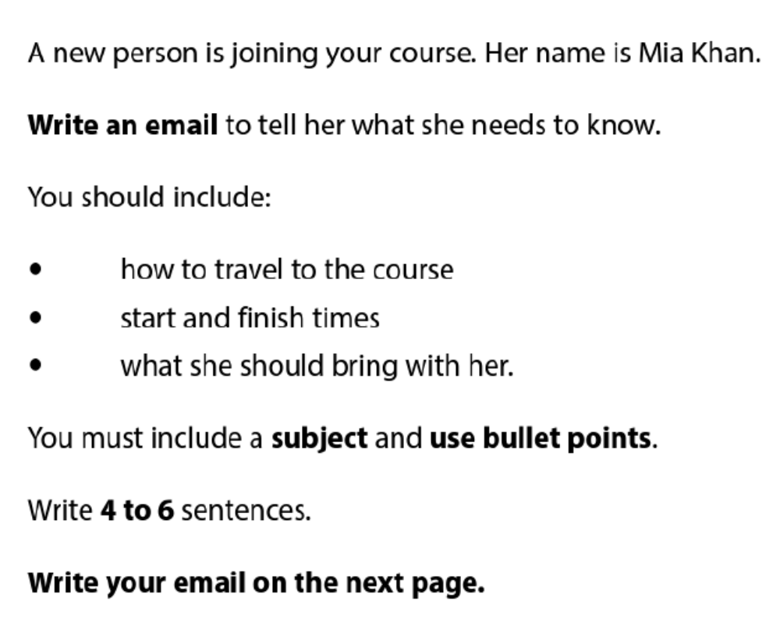
HOMEWORK

