Slide 1
Functional Skills English Entry 3
FORMAL LETTER WRITING

Slide 2
Session Aims
By the end of this session, learners will be able to:
Understand the purpose of a formal letter
Follow the correct layout for an Entry 3 formal letter
Write a clear formal letter that includes all the required information
Use a polite greeting and closing
Write at least 8 sentences, including at least 3 compound sentences
Use at least 2 paragraphs

Slide 3
Warm-Up: “Who Deserves a Thank You?”
Think of someone in your community, college or workplace who helps other people.
Tell your partner:
Who is this person?
What does he or she do to help others?
Why do you think this person is special?
Be ready to share one example with the class.

Slide 4
What is a formal letter?
Simple explanation for Entry 3 learners
Definition
Purpose
Audience
A formal letter is a written message for an official purpose. It usually has addresses, a date, a polite greeting, paragraphs and a closing.
• suggest someone
• make a request
• give information
• explain a problem
• council
• manager
• school or college
• organisation
Purpose + audience + tone = better writing.
Formal Letter Writing • Entry 3 • 4/12

Slide 5
Exam requirements
Use this as your checklist in the writing exam.
Must include
Success criteria
• 8+ sentences
• 3+ compound sentences
• 2+ paragraphs
• addresses, date and closing
• answer every bullet point
• use the correct layout
• write in a logical order
• check spelling, punctuation and grammar
Do not start writing until you know exactly what the question asks you to include.
Formal Letter Writing • Entry 3 • 5/12

Slide 6
Layout/template for the exam
Put the right information in the right place.
Order of parts
Your address
• Your address
• Their address
• Date
• Greeting
• Paragraphs
• Closing
Their address
Date
Greeting
Paragraphs
+ Closing
In the exam, layout helps the reader follow your answer quickly.
Formal Letter Writing • Entry 3 • 6/12

Slide 7
Part 1: Opening
Start clearly so the reader understands the purpose.
What to do
Useful starts
• Write the addresses and date.
• Use a polite greeting.
• Say why you are writing.
• I am writing to…
• I would like to…
• I want to tell you about…
• This review/article is about…
Formal Letter Writing • Entry 3 • 7/12

Slide 8
Part 2: Main writing
Use the task bullets and add enough detail.
Main points
Sentence support
• Use paragraphs for each point.
• Give two examples or reasons.
• Use formal language and clear detail.
• Use and to add detail.
• Use but to show contrast.
• Use because to give a reason.
• Use so to show a result.
Formal Letter Writing • Entry 3 • 8/12

Slide 9
Ending and tone
Finish properly and sound right for the reader.
Ending
Tone
• Summarise your idea.
• Use a polite final sentence.
• Close correctly: Yours sincerely / Yours faithfully/ Kind regards,
• formal
• polite
• respectful
• clear and serious
Formal Letter Writing • Entry 3 • 9/12

Slide 10
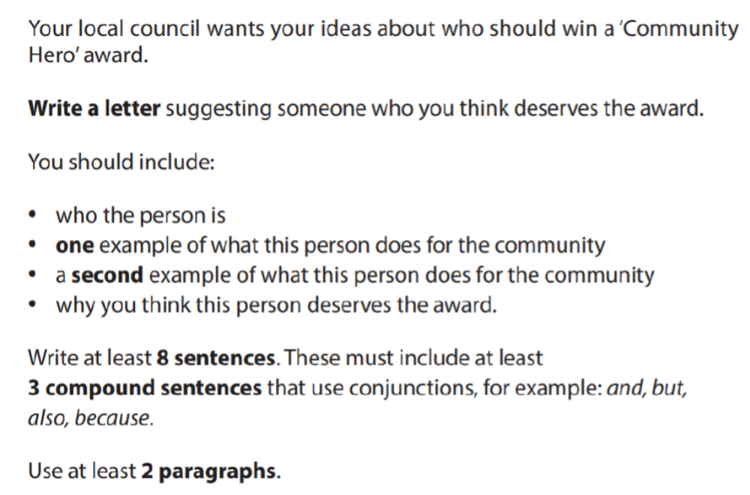
Exam Question
Exam Rules
At least 8 sentences
At least 3 compound sentences
At least 2 paragraphs

Slide 11
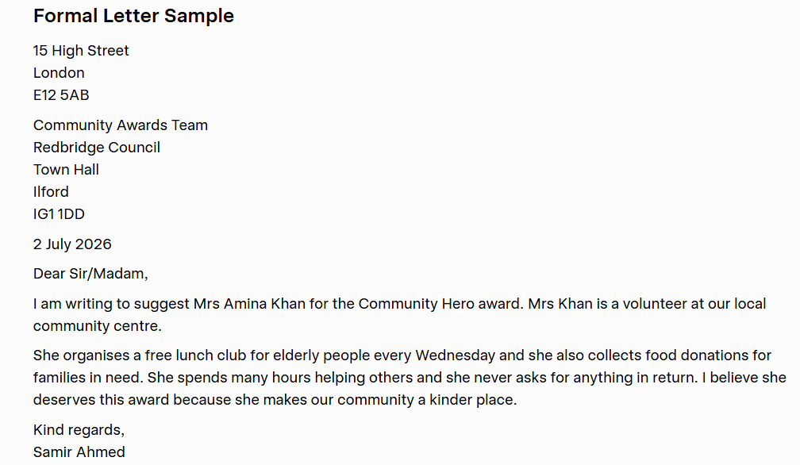

Slide 12
Final check and plenary
Check your answer before you hand it in.
Content
Accuracy
Layout
• Did I answer all bullets?
• Did I add enough detail?
• Is the order logical?
• Capital letters?
• Full stops?
• Correct tense?
• Spelling checked?
• Right format?
• Paragraphs or bullets?
• Good opening and ending?
Exit question: What is one thing you will remember in the exam?
Formal Letter Writing • Entry 3 • 12/12

Slide 13
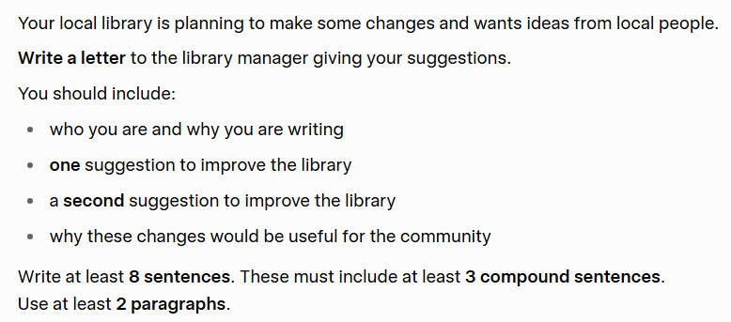
HOMEWORK

