Slide 1
Functional Skills English Level 1
Formal Email Writing
How to write a clear, polite and well-structured formal email

Slide 2
Session Aims
By the end of this lesson, you will be able to:
• understand the purpose of a formal email
• identify the main features of formal email writing
• understand the Pearson email template
• use formal and polite language
• organise information into clear paragraphs
• write and check a formal email

Slide 3
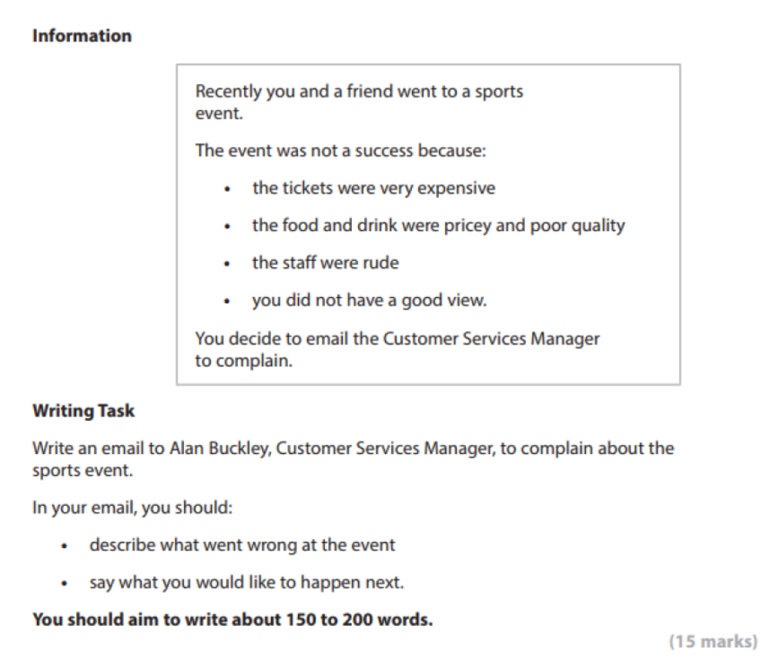
Pearson Formal Email Task

Slide 4
What Is a Formal Email?
Definition: A formal email is a professional message sent to someone you do not know well, or to someone in an official role.
A formal email should:
• have a clear email address and subject/title
• use a polite opening greeting
• explain clearly why you are writing
• give relevant details in paragraphs
• say what you want to happen next
• end with a polite closing

Slide 5
Purpose and Audience
Purpose
• to give information clearly
• to complain politely or make a request
• to explain a problem and ask for action
Audience
• a manager, company, organisation or person in an official role
• The tone should be formal, polite and clear.

Slide 6
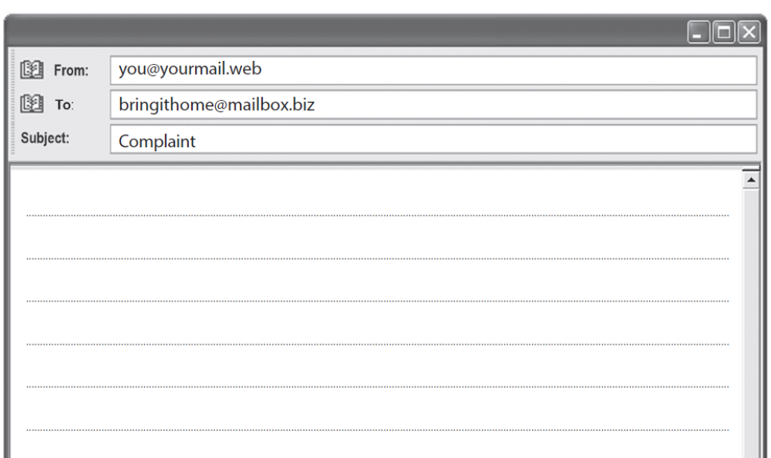
Very Important!
In the Pearson Level 1 Email Exam:
The From, To, and Subject lines are usually already filled in by the examiner.
You do not need to write them again.
You should start your email directly with the greeting/salutation.

Slide 7
Standard Email Layout (Template)
Email Structure (Always use this order)
Email Address (sender’s and receiver’s) (From & To)
Title of Email (Subject line)
Opening Greeting (Dear Mr/Ms …,)
Introductory Paragraph – Why you are writing
Main Body – Cover all bullet points from the question
Closing Paragraph – Polite ending + what you want
Closing Salutation (Yours sincerely, / Best regards,)
Your Full Name
Always follow this layout. It helps you organise your email and get better marks.
Usually already filled in

Slide 8
Useful Formal Email Language
Useful sentence starters:
• I am writing to complain about...
• I am disappointed because...
• First of all,... / In addition,...
• Another problem was...
• I would like...
• I look forward to hearing from you.
Use formal language. Avoid slang, emojis and chatty phrases.

Slide 9
Model Formal Email
TO: alanbuckley@customerservices.biz
Title of email: Complaint About Sports Event
Dear Mr Buckley,
I am writing to complain about a sports event I attended with a friend on Saturday 10 August. We were looking forward to the event, but sadly it was very disappointing.
First of all, the tickets were extremely expensive, but the experience did not match the price. The food and drinks inside the stadium were also overpriced and poor quality. My burger was cold, and my drink was almost flat. In addition, some members of staff were rude when we asked for help. They did not listen carefully and gave short, unhelpful answers.
Another problem was our view. We could not see the main part of the event clearly because a large post was blocking the stage. This meant we could not enjoy the performance properly.
I would like a written apology and a partial refund for the tickets. I also think staff should receive customer service training.
I look forward to hearing from you.
Yours sincerely,
Aisha Khan
Word count: 162 words, excluding email address and title.

Slide 10
Check Your SPaG and Layout
Before you finish, check:
• Have I used the correct email address?
• Have I included a clear title/subject?
• Have I used a formal greeting and closing?
• Have I explained why I am writing?
• Have I included all the important details?
• Have I said what I want to happen next?
• Have I checked spelling, punctuation and grammar?
• Have I written about 150 to 200 words?

Slide 11
Class Practice – Formal Email
You recently joined a gym, but you are unhappy with the service.
Write an email to the gym manager to complain.
In your email, you should:
• explain when you joined the gym
• describe two problems, such as broken equipment or cancelled classes
• explain how the problems affected you
• say what you would like the manager to do next
Aim to write 150 to 200 words.

Slide 12
Homework – Formal Email
You ordered a new phone online, but it arrived late and the charger was missing.
Write an email to the customer services team.
In your email, you should:
• explain what you ordered and when it arrived
• describe the problems with the order
• explain how this affected you
• say what you would like the company to do next
Aim to write 150 to 200 words.

