Slide 1
Functional Skills English Entry 3
FORMAL EMAIL WRITING

Slide 2
Session Aims
By the end of this session, learners will be able to:
Understand the purpose of a formal email
Use the correct layout for a formal email
Write a clear subject line
Use formal language and polite expressions
Include bullet points where needed
Write 8+ sentences with at least 3 compound sentences

Slide 3
Warm-up
Look at these two openings. Which one is formal? Which one is informal? Why?
Hi Sam, how are you?
Dear Mr Khan,
Discuss with a partner.

Slide 4
What is an Email?
A Digital Letter
Email stands for Electronic Mail. Think of it as sending a letter, but instead of using a pen, paper, and a stamp, you use a computer or phone.
Why do we use them?
  Fast: It arrives in seconds, not days.
  Free: You don't need to buy a stamp!
  Universal: You can send them to friends, family, or businesses anywhere in the world.
Just like a real letter, it still needs an address (email address) and a message inside!

Slide 5
What is a formal email?
Simple explanation for Entry 3 learners
Definition
Purpose
Audience
A formal email is a polite message to someone you do not know well, such as a manager, tutor, receptionist or organisation.
• give information
• ask for help
• make a request
• explain a problem
• manager
• tutor
• college office
• customer service
Purpose + audience + tone = better writing.
Formal Email Writing • Entry 3 • 4/12

Slide 6
CORRECT LAYOUT (FORMAL EMAIL)
To: (who you are writing to)
From: (your name)
Subject: (short and clear)
Greeting: Dear Mr/Ms + surname
Introduction (why you are writing)
Main points (use bullet points if giving details)
Closing (Kind regards,)
Your full name

Slide 7
Exam requirements
Use this as your checklist in the writing exam.
Must include
Success criteria
• 4–6 sentences
• subject line
• bullet points
• polite opening and closing
• answer every bullet point
• use the correct layout
• write in a logical order
• check spelling, punctuation and grammar
Do not start writing until you know exactly what the question asks you to include.
Formal Email Writing • Entry 3 • 5/12

Slide 8
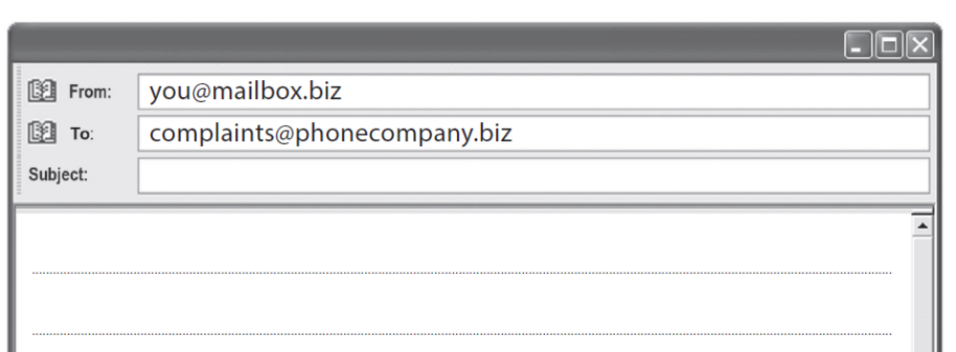
CORRECT LAYOUT (FORMAL EMAIL)
Note:
In the Pearson Entry 3 exam, the To and From boxes are already given for you.
You only need to write the Subject the message, and the bullet points.

Slide 9
The Subject Line
The Subject Line = The Book Title
It tells the reader what the email is about before they open it.
Rule: Keep it short (3-6 words).
Examples:
❌ Bad: "Hello how are you I want to ask about the party." (Too long!)
✅ Good (Informal): Invitation to my party
✅ Good (Formal): Complaint about broken TV
✅ Good (Formal): Job Application

Slide 10
FORMAL SALUTATION (GREETING)
Use a formal greeting:
Dear Sir/Madam,
Dear Mr Khan,
Dear Ms Ahmed,
Always put a comma after the name.

Slide 11
FORMAL OPENING SENTENCE
Start your email with a clear purpose:
I am writing to complain about…
I am writing to enquire about…
I am writing to request…
I would like to inform you that…
Keep it polite and clear.

Slide 12
FORMAL CLOSING (GOODBYE)
End your email politely:
Kind regards,
Yours sincerely,
Yours faithfully,
Then write your full name.

Slide 13
USEFUL LANGUAGE
I am writing to…
I would like to…
Could you please…
I look forward to hearing from you.
Kind regards,

Slide 14
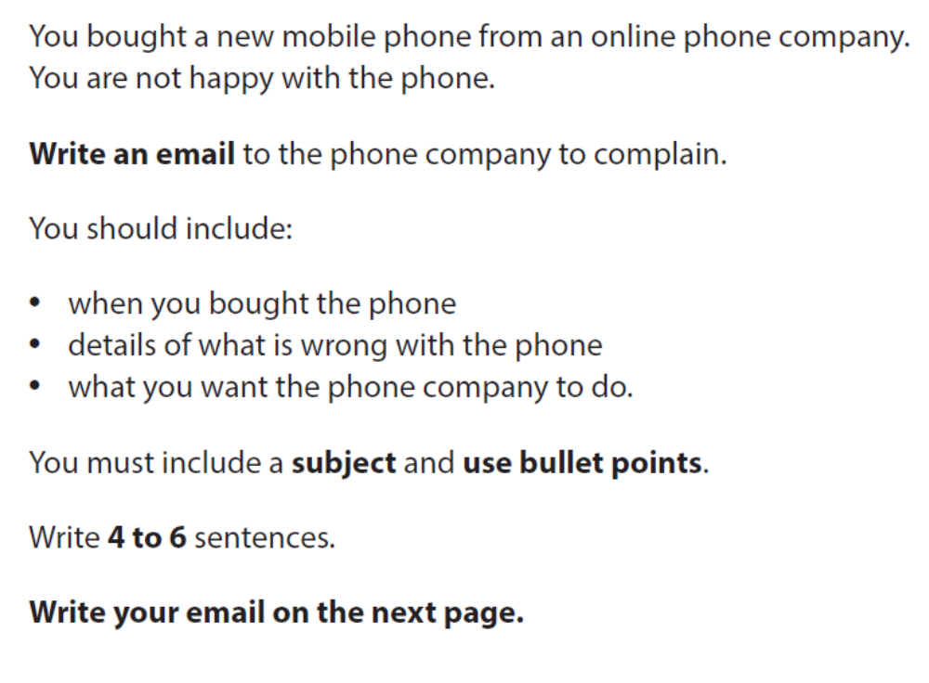
SAMPLE EXAM STYLE QUESTION

Slide 15
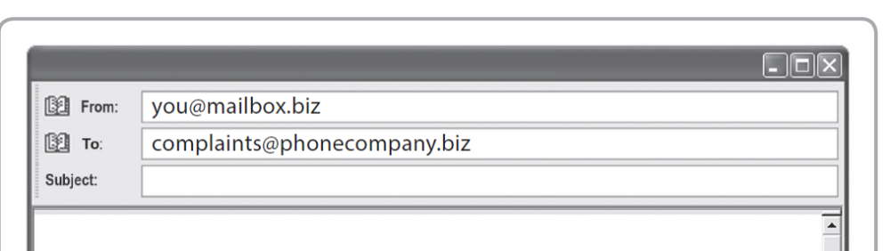
SAMPLE ANSWER
Subject: Complaint about my new mobile phone
Dear Sir/Madam,
I am writing to complain about a mobile phone I bought from your company on 5th August.
Here are the details:
The screen is cracked.
The battery only lasts for two hours.
The phone turns off by itself.
I would like a full refund or a replacement phone as soon as possible.
Kind regards,
Amina Khan

Slide 16
Final check and plenary
Check your answer before you hand it in.
Content
Accuracy
Layout
• Did I answer all bullets?
• Did I add enough detail?
• Is the order logical?
• Capital letters?
• Full stops?
• Correct tense?
• Spelling checked?
• Right format?
• Paragraphs or bullets?
• Good opening and ending?
Exit question: What is one thing you will remember in the exam?
Formal Email Writing • Entry 3 • 12/12

Slide 17
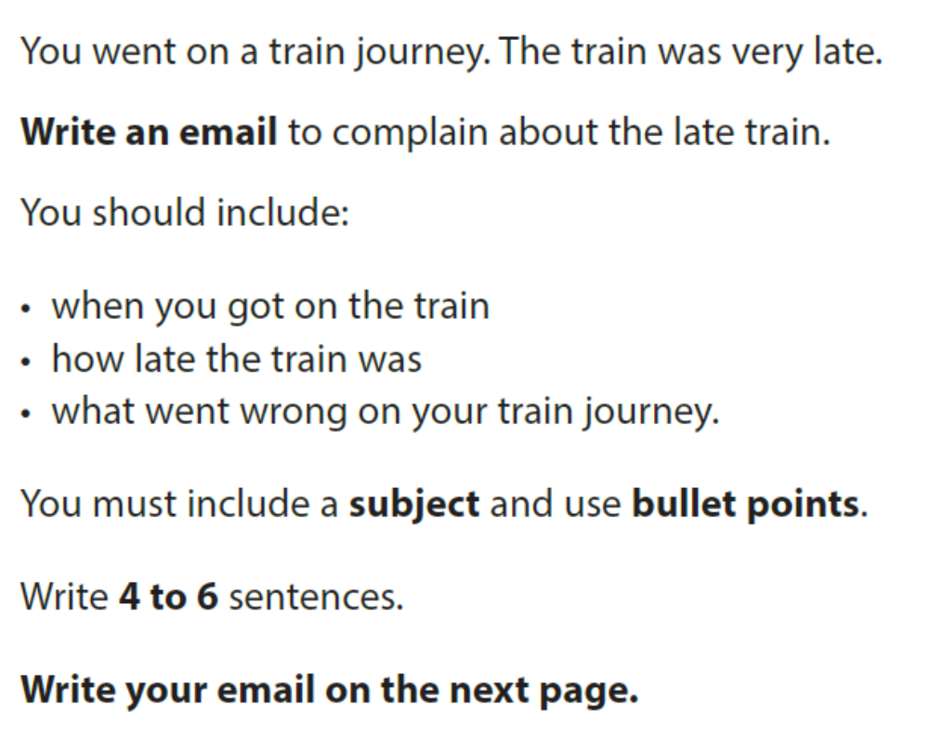
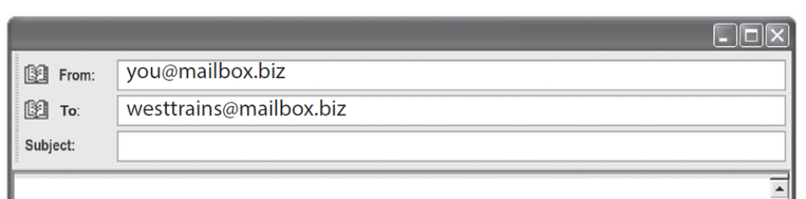
HOMEWORK

