Slide 1
Functional Skills English Level 1
Diary Writing
How to write a clear, personal and well-structured diary entry

Slide 2
Session Aims
By the end of this lesson, you will be able to:
• understand the purpose of a diary entry
• identify the main features of diary writing
• understand the Pearson diary entry template
• describe a place clearly and personally
• explain what makes a place special
• write a diary entry and check your SPaG

Slide 3
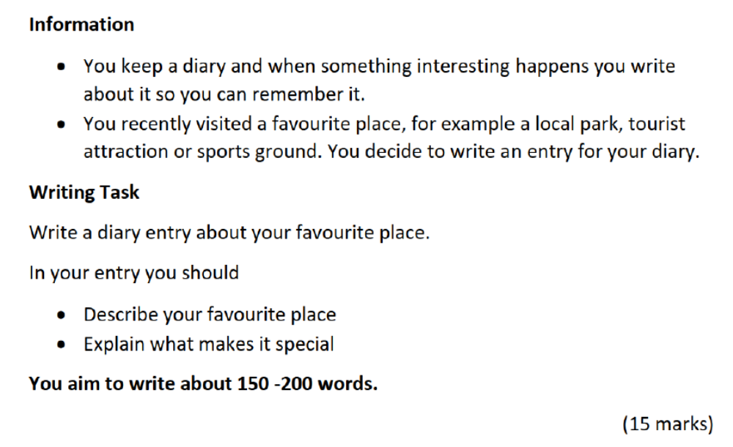
Pearson Diary Writing Task

Slide 4
What Is a Diary Entry?
Definition: A diary entry is a personal piece of writing about an experience, event, place or feeling.
It is usually written for yourself, so the language can sound natural and personal.
A diary entry should:
• include the date
• use first person, such as I, me and my
• describe what happened or what you experienced
• include thoughts and feelings
• be organised into clear paragraphs

Slide 5
Purpose and Audience
Purpose
• to record an experience or memory
• to describe something important to you
• to explain your thoughts and feelings
Audience
• A diary is usually written for yourself.
• The tone can be personal, but the writing must still be clear and organised.

Slide 6
Pearson Diary Entry Template
The Pearson writing frame is divided into these parts:
• Date
• Describe your favourite place
• Explain what makes it special for you
You should aim to write about 150 to 200 words.
Tip: A diary entry can include feelings and personal reasons, but it should still answer the task fully.

Slide 7
Explaining the Layout
Date: write the date clearly at the top.
Opening: say where you went and when you went there.
Description: describe the place using clear details.
Feelings: explain how the place made you feel.
Special meaning: explain why the place is important to you.
Ending: finish with a final thought or feeling.

Slide 8
Useful Diary Language
Useful sentence starters:
• Today, I visited...
• It is one of my favourite places because...
• When I arrived, I noticed...
• I felt... because...
• What makes this place special is...
• I will always remember this place because...
Use descriptive words and connectives such as because, also, when, while and finally.

Slide 9
Model Diary Entry
Saturday 14 September 2026
Today I visited Valentines Park, one of my favourite places in my local area. I went there in the afternoon after a busy week at college, and it felt relaxing as soon as I walked through the gate.
The park is wide and green, with tall trees, open grass and a beautiful lake. I enjoyed watching families having picnics, children playing and people walking slowly around the water. The weather was warm, so I sat on a bench and listened to the birds for a while.
This place is special to me because it helps me feel calm. When I am stressed, a short walk there clears my mind and gives me fresh energy. It is also a good place to spend time with my family without spending money.
I came home feeling peaceful and happy. I think I will visit again next weekend because it is a simple place that always makes me feel better.
Word count: 156 words, excluding the date.

Slide 10
Check Your SPaG and Structure
Before you finish, check:
• Have I written the date?
• Have I used first person: I, me, my?
• Have I described the place clearly?
• Have I explained why it is special?
• Have I included thoughts and feelings?
• Have I used paragraphs?
• Have I checked spelling, punctuation and grammar?
• Have I written about 150 to 200 words?

Slide 11
Class Practice – Diary Writing
You recently spent a day with a friend or family member and enjoyed it.
Write a diary entry about the day.
In your diary entry, you should:
• say where you went and who you were with
• describe what you did
• explain why the day was special or enjoyable
• include your thoughts and feelings
Aim to write 150 to 200 words.

Slide 12
Homework – Diary Writing
You recently attended an event, such as a wedding, festival, party, school event or sports day.
Write a diary entry about the event.
In your diary entry, you should:
• say what the event was and when it happened
• describe what you saw or did
• explain what made the event memorable
• include your thoughts and feelings
Aim to write 150 to 200 words.

