Slide 1
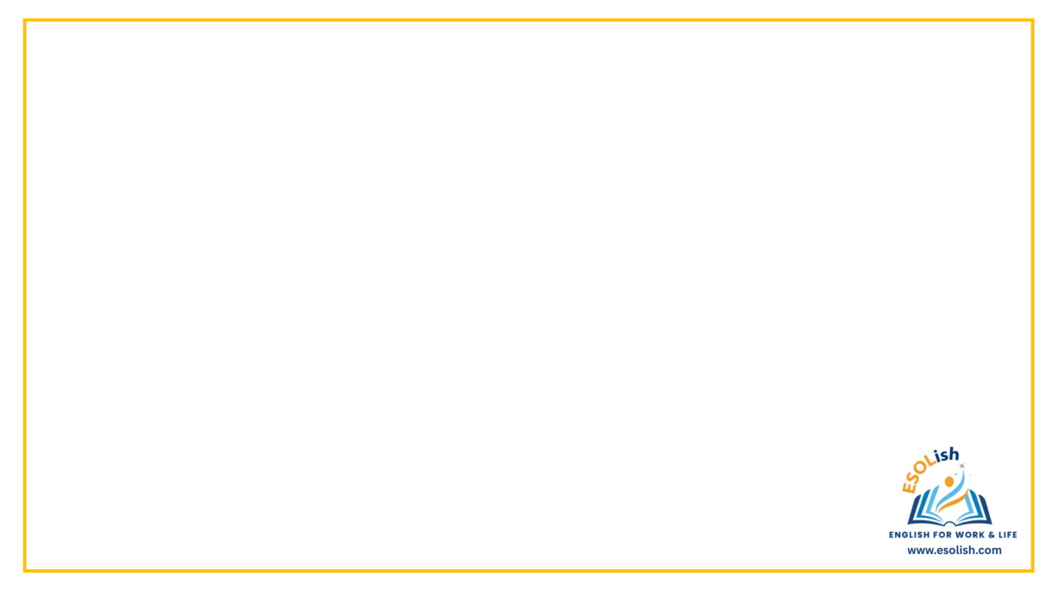
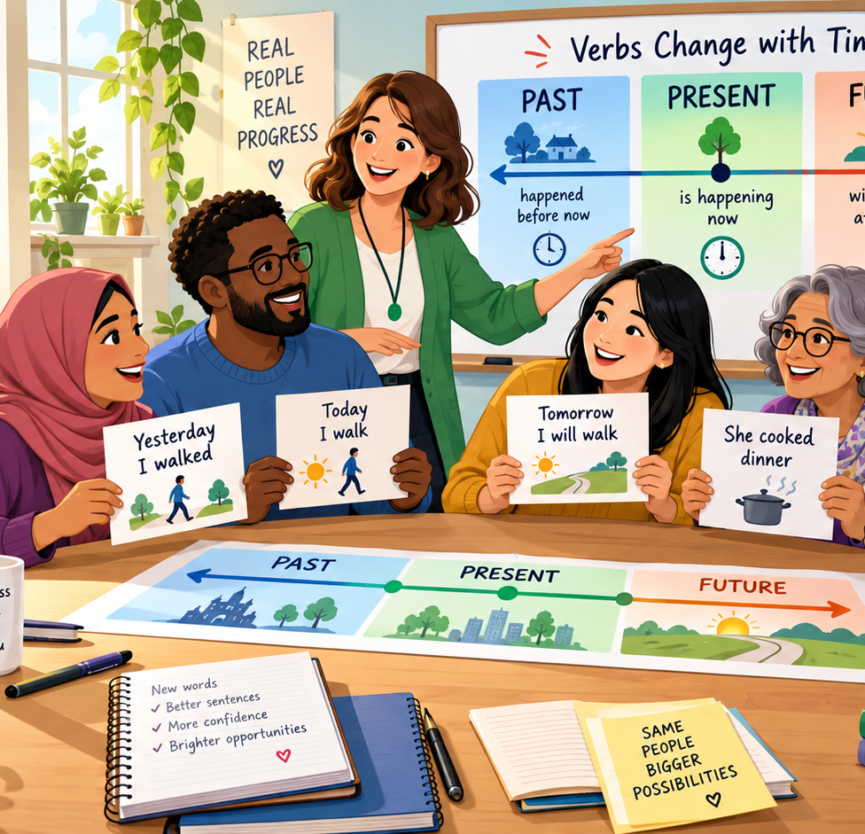
Correct Tense
Past • Present • Future
Functional Skills English Entry 3
Today’s big idea
The verb must show the correct time.
Yesterday = past • Now = present • Tomorrow = future
Correct Tense | Functional Skills English Entry 3 | 1

Slide 2
Session aims
Entry 3 Grammar
AIMS
By the end of the lesson, you will be able to…
say what tense means.
recognise past, present and future sentences.
choose the correct verb tense in short texts.
keep the tense the same when writing.
check and correct simple tense mistakes.
Exam link
In Entry 3 writing, you need mostly correct grammar.
Correct tense helps your writing make sense.
You may need to write about what happened, what happens now or what will happen.
Correct Tense | Functional Skills English Entry 3 | 2

Slide 3
What is tense?
GRAMMAR
Tense tells us WHEN something happens.
A verb can show past, present or future time.
PAST
before now
Yesterday I walked.
PRESENT
now / every day
I walk every day.
FUTURE
after now
Tomorrow I will walk.
Tip: Look for time words first.
Correct Tense | Functional Skills English Entry 3 | 3

Slide 4
Present tense: now or usually
PRESENT
Use present tense for…
things happening now: She is cooking now.
routines: I study on Mondays.
facts: The bus arrives at 9 am.
Simple present pattern
I / you / we / they + verb
They work in a shop.
he / she / it + verb + s
She works in a shop.
Correct Tense | Functional Skills English Entry 3 | 4

Slide 5
Past tense: finished actions
PAST
Regular verbs usually add -ed
walk → walked
clean → cleaned
start → started
Yesterday, I cleaned the kitchen.
Some verbs change completely
go → went
buy → bought
make → made
see → saw
Last week, I went to college.
Correct Tense | Functional Skills English Entry 3 | 5

Slide 6
Future tense: after now
FUTURE
Use “will” + verb
I will attend the course.
She will call the doctor.
They will arrive at 10 am.
Use “going to” + verb
I am going to revise tonight.
He is going to apply for a job.
We are going to check our writing.
Correct Tense | Functional Skills English Entry 3 | 6

Slide 7
Time words are clues
CLUES
Past clues
yesterday
last week
last year
ago
in 2020
Present clues
now
today
every day
usually
often
Future clues
tomorrow
next week
soon
later
in the future
Correct Tense | Functional Skills English Entry 3 | 7

Slide 8
Keep the tense the same
CHECK
Important rule
If all the actions happened at the same time, keep the same tense.
Instead of: Yesterday I go to town and buy a coat.
Say/write: Yesterday I went to town and bought a coat.
Instead of: Every day she walked to work and meets her friend.
Say/write: Every day she walks to work and meets her friend.
Change tense only when the time changes.
Correct Tense | Functional Skills English Entry 3 | 8

Slide 9
Common tense mistakes
FIX IT
Instead of: Yesterday I go to class.
Say/write: Yesterday I went to class.
Instead of: She work every Saturday.
Say/write: She works every Saturday.
Instead of: Tomorrow I visited my aunt.
Say/write: Tomorrow I will visit my aunt.
Instead of: He cook dinner now.
Say/write: He is cooking dinner now.
Exam tip
Always read your sentence again and ask: “When did this happen?”
Correct Tense | Functional Skills English Entry 3 | 9

Slide 10
Quick test 1: What tense is it?
YOUR TURN
Write PAST, PRESENT or FUTURE.
1. Last night, I watched a film.
2. She usually takes the bus.
3. We will start the course next week.
4. They are waiting outside now.
5. He bought a ticket yesterday.
Correct Tense | Functional Skills English Entry 3 | 10

Slide 11
Quick test 1: Answers
ANSWERS
Check your answers
1. watched = PAST
2. usually takes = PRESENT
3. will start = FUTURE
4. are waiting now = PRESENT
5. bought yesterday = PAST
Correct Tense | Functional Skills English Entry 3 | 11

Slide 12
Quick test 2: Choose the correct verb
EXAM STYLE
Choose the correct verb in brackets.
1. Yesterday, I (go / went) to the library.
2. Every morning, my son (eat / eats) breakfast at 8 am.
3. Next week, we (visited / will visit) the museum.
4. The learners (are writing / wrote) now.
5. Last year, she (study / studied) English online.
Correct Tense | Functional Skills English Entry 3 | 12

Slide 13
Plenary: Check your writing
CHECKLIST
Quick test 2 answers
1. went
2. eats
3. will visit
4. are writing
5. studied
Before you finish writing, ask:
1. What time am I writing about?
2. Is the verb correct?
3. Did I keep the tense the same?
4. Did I check irregular verbs?
Correct Tense | Functional Skills English Entry 3 | 13

