Slide 1
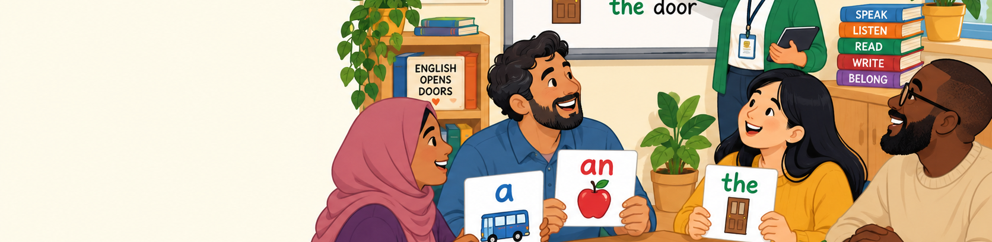
FUNCTIONAL SKILLS ENGLISH ENTRY 3
Definite & Indefinite Articles
a, an and the | Functional Skills English Entry 3
Today’s focus
Use articles accurately in everyday writing and exam-style sentences.

Slide 2
Today’s lesson
Learn when to use a, an and the in simple, clear sentences.
By the end, learners can...
• explain the difference between a, an and the.
• choose a or an using the sound rule.
• use the for something specific or already mentioned.
• avoid common article mistakes in short writing.
Why it matters
Correct articles make writing clearer and more natural. They are also part of grammar accuracy in Entry 3 writing.
Quick memory
a / an = one general thing
the = one specific thing
Definite & Indefinite Articles | 2/16

Slide 3
What is an article?
An article is a small word before a noun.
Article
A small word before a noun.
Noun
A person, place or thing.
Examples: bus, apple, door, learner.
Examples
a bus
an apple
the door
Simple sentence
I opened the door.
She bought an orange.
He waited for a bus.
Definite & Indefinite Articles | 3/16

Slide 4
The three key words
a / an / the
a
one general thing
before a consonant sound
a bus • a pen • a college
an
one general thing
before a vowel sound
an apple • an email • an hour
the
one specific thing
or already known
the bus stop • the email • the first lesson
Remember
A and an are indefinite articles. The is the definite article.
Definite & Indefinite Articles | 4/16

Slide 5
A and an = one general thing
Use a or an when the reader does not know exactly which one.
Use a / an when...
• you mean one thing, but not a special one.
• the reader does not know exactly which one yet.
• you mention something for the first time.
Examples
I saw a cat.
She needs an appointment.
We read a notice.
Ask yourself
Is it one general thing?
If yes, use a or an.
Definite & Indefinite Articles | 5/16

Slide 6
A or an? Listen to the sound
Use the sound at the start of the next word.
Use a before consonant sounds
a bus
a lesson
a university
Use an before vowel sounds
an apple
an email
an hour
Important
It is about the sound, not just the first letter.
“university” starts with a /y/ sound → a university
“hour” starts with a vowel sound → an hour
Definite & Indefinite Articles | 6/16

Slide 7
The = one specific thing
Use the when the reader knows exactly which one.
Use the when...
• there is only one clear thing.
• you and the reader both know which one.
• you have already mentioned it.
• there is a specific place or item.
Examples
Please close the window.
The teacher gave us a worksheet.
I am going to the library near my house.
Memory question
Which one? If the answer is clear, use the.
Definite & Indefinite Articles | 7/16

Slide 8
First mention / second mention
Use a or an first, then the.
First time
I saw a dog.
Second time
The dog was friendly.
Why?
First sentence: the reader does not know the dog.
Second sentence: now we know which dog.
Your turn
I bought ___ phone. ___ phone was expensive.
Definite & Indefinite Articles | 8/16

Slide 9
What about plural nouns?
Do not use a/an with plural nouns.
Do NOT use a/an with plural nouns
a books ✗
an apples ✗
Use plural without a/an
books ✓
apples ✓
learners ✓
Examples
I bought books.
The books are on the table.
Learners need pens.
Definite & Indefinite Articles | 9/16

Slide 10
What about uncountable nouns?
Some nouns do not usually take a/an.
Some nouns are not counted with a/an
water • advice • information • homework
Say this
I need some advice.
She gave me information.
The homework is difficult.
Be careful
Do not say: an advice ✗ / an information ✗ / a homework ✗
Definite & Indefinite Articles | 10/16

Slide 11
Common mistakes
Spot and correct typical article errors.
Correct the mistakes
1. I saw an bus.
2. She needs a umbrella.
3. I bought a books.
4. Teacher gave me the advice.
Correct answers
1. a bus
2. an umbrella
3. books / some books
4. some advice / advice
Tip
Read your sentence aloud. The sound often helps you choose a or an.
Definite & Indefinite Articles | 11/16

Slide 12
Quick test 1
Choose a, an or the.
1. I waited for ___ bus.
Answer: a bus
2. She sent ___ email.
Answer: an email
3. Please open ___ door.
Answer: the door
4. He has ___ umbrella.
Answer: an umbrella
5. I found ___ interesting article.
Answer: an interesting article
6. ___ article was about healthy eating.
Answer: The article
Definite & Indefinite Articles | 12/16

Slide 13
Quick test 2
Complete the short text.
Complete the text
Yesterday, I read ___ notice at college. ___ notice said that ___ English class was in Room 6. I asked ___ receptionist for help. She gave me ___ map.
Answers
a notice • The notice • the English class • a receptionist • a map
Definite & Indefinite Articles | 13/16

Slide 14
Partner practice
Say it, choose it, explain it.
Partner A
Choose a card and make a sentence with a, an or the.
Partner B
Listen and say if the article is correct. Explain why.
Useful language
I chose ___ because...
It is general / specific.
It starts with a vowel sound / consonant sound.
Definite & Indefinite Articles | 14/16

Slide 15
Mini writing task
Use articles in your own sentences.
Writing task
Write 5 sentences about your journey, class or home.
Use a, an and the at least once.
Check your writing
• Have I used a/an for one general thing?
• Have I used the for something specific?
• Have I checked plural nouns?
• Have I read it aloud?
Definite & Indefinite Articles | 15/16

Slide 16
Plenary and homework
Check your understanding.
Exit ticket
Complete the rule:
Use a/an for ________.
Use the for ________.
Homework
Find 5 sentences at home or online. Underline a, an or the. Write why the writer used it.
Well done!
Small grammar changes make big improvements in writing.
Definite & Indefinite Articles | 16/16

