Slide 1
Functional Skills English Entry 3
ARTICLE WRITING

Slide 2
Session Aims
By the end of this session, learners will be able to:
Understand what an article is and why we write one
Follow the correct layout for an Entry 3 article (title + 2 paragraphs)
Include all the required information from the question
Write at least 8 sentences, including at least 3 compound sentences
Use linking words (and, but, because, so, or) and the word “However”
Produce a clear, friendly article suitable for a college or work newsletter

Slide 3
Warm-up: Share One Thing
Think about your first day at college, at work, or in a new place.
Tell your partner one short sentence about:
something you did
someone you met
something you liked, or
something you disliked
Be ready to share it with the class.

Slide 4
What is an article?
Simple explanation for Entry 3 learners
Definition
Purpose
Audience
An article is a short piece of writing for a newsletter, website or magazine. It gives information and may include opinions or feelings.
• share information
• describe an experience
• explain what happened
• interest the reader
• college learners
• work colleagues
• website readers
• newsletter readers
Purpose + audience + tone = better writing.
Article Writing • Entry 3 • 4/12

Slide 5
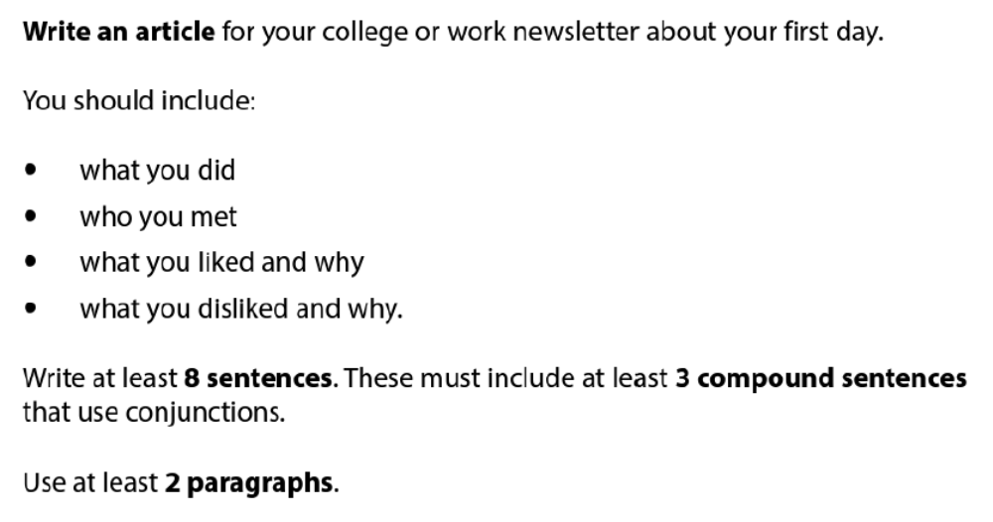
ARTICLE WRITING QUESTION
(According to the Pearson template)

Slide 6
Layout / Parts of an Article
(According to the Pearson template)
1. Title: A short, clear heading that tells the reader what the article is about. Example: My First Day at College
2. Paragraph 1 – The Facts (Introduction)
When did you start / when did it happen?
What did you do?
Who did you meet?
3. Paragraph 2 – Your Opinions
What did you like and why?
What did you dislike and why? (Use the word However to move from like to dislike)
4. Conclusion (short closing sentence) Say how you felt overall or what you hope for the future.

Slide 7

Exam Rules you must follow:
At least 8 sentences (aim for 10 to be safe)
At least 3 compound sentences (use the glue words)
At least 2 paragraphs

Slide 8
Compound Sentences

Slide 9
Warm-Up
Look at these sentences. Which ones are compound sentences? Why?
I arrived early and I felt nervous.
The classroom was big and bright.
I met my tutor but I forgot her name.
The lesson was interesting but long.
I wanted a coffee and a sandwich.
It was raining but I did not have an umbrella.
The students were friendly and helpful.
I liked the teacher and she explained everything clearly.

Slide 10
Simple Definition
A compound sentence joins two complete ideas together using a linking word such as and, but, because, so or or.
Each part of the sentence has its own subject and verb.
EXAMPLE:
I arrived early and I felt nervous. (Joins two full ideas with a subject + verb on both sides)
The students were friendly and helpful. (This only has one main idea, even though it uses “and” or “but”)

Slide 11
The “Glue” Words (Compound Sentences)
These words join two ideas together:
Word | Meaning | Example
and | Adding information | The room was big and it was bright.
but | Showing a difference | I wanted to talk, but I felt shy.
because | Giving a reason | I arrived early because I was nervous.
so | Showing a result | It was cold, so I wore a jacket.
or | Giving a choice | We could sit inside or we could go outside.

Slide 12
Magic word: However
Use it to change direction (from positive to negative). Always put a full stop before it and a comma after it.
Example: I liked the friendly teachers. However, the timetable was very busy.

Slide 13
ARTICLE WRITING QUESTION AND SAMPLE ANSWER
(According to the Pearson template)

Slide 14
Article Writing: Sample Answer
Title: My First Day at College
Last Monday I started my Functional Skills English course at college. I arrived at 9 o’clock and went to the reception. A kind lady showed me where to go and I met my tutor, Mrs Khan. She was very friendly and she introduced me to the other students in the class.
I liked the classroom because it was bright and clean. The other learners were helpful and we talked about our goals. However, I did not like the long corridor because it was noisy and I felt a bit lost at first. Overall, I had a good first day and I am looking forward to the next lesson.

Slide 15
Final check and plenary
Check your answer before you hand it in.
Content
Accuracy
Layout
• Did I answer all bullets?
• Did I add enough detail?
• Is the order logical?
• Capital letters?
• Full stops?
• Correct tense?
• Spelling checked?
• Right format?
• Paragraphs or bullets?
• Good opening and ending?
Exit question: What is one thing you will remember in the exam?
Article Writing • Entry 3 • 12/12

Slide 16
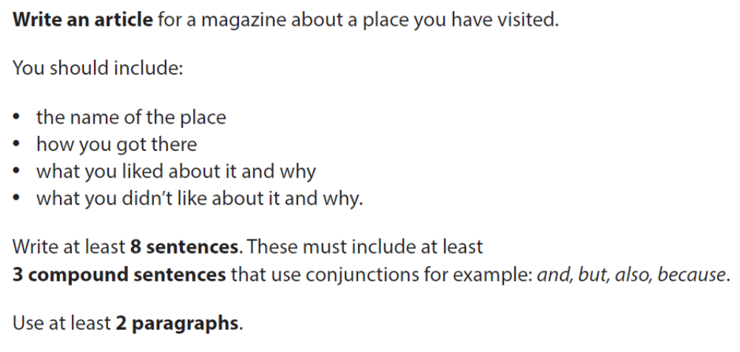
HOMEWORK

