Slide 1
Functional Skills English Level 1
Article Writing
How to write a clear, interesting and well-structured article

Slide 2
Session Aims
By the end of this lesson, you will be able to:
• understand the purpose of an article
• identify the main features of article writing
• understand the Pearson article template
• write a clear title and introduction
• explain your ideas with reasons and examples
• write a suitable conclusion and check your SPaG

Slide 3
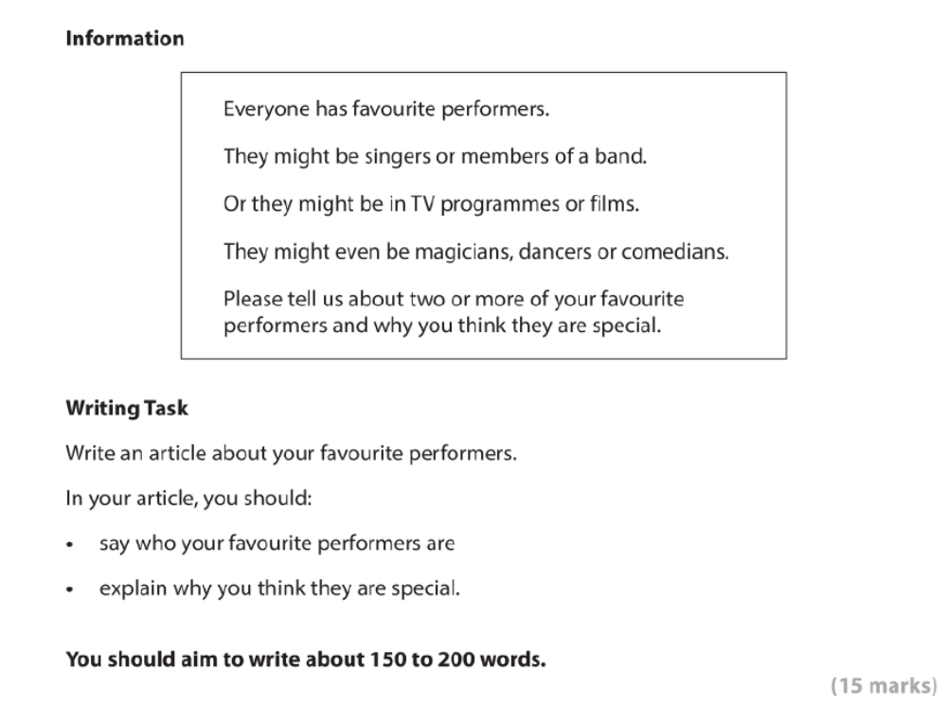
Sample Pearson Article Writing Task

Slide 4
What Is an Article?
Definition: An article is a piece of writing for readers of a magazine, website, newsletter or newspaper.
It usually gives information, ideas, opinions and reasons about a topic.
An article should:
• have a clear title
• interest the reader
• organise ideas into paragraphs
• give reasons and examples
• finish with a short conclusion

Slide 5
Purpose and Audience
Purpose
• to inform, explain and interest the reader
• to give your opinion with reasons
• to share useful or interesting information
Audience
• people who read a magazine, website or newsletter
The language should be clear, interesting and suitable for the reader.

Slide 6
Pearson Article Template
The Pearson writing frame is divided into these parts:
• Headline / Title
• Introductory paragraph: Who are you writing about?
• Paragraph 1: Why is performer one special?
• Paragraph 2: Why is performer two special?
• Conclusion: Give your final opinion.

Slide 7
Explaining the Layout
Headline / Title: short, clear and interesting.
Introduction: introduce the topic and name the performers.
Main paragraph 1: explain why the first performer is special.
Main paragraph 2: explain why the second performer is special.
Conclusion: sum up your opinion in one or two sentences.
Tip: Each paragraph should have a clear job.

Slide 8
Useful Language for Articles
Useful sentence starters:
• One of my favourite performers is...
• I admire him/her because...
• Another performer I enjoy is...
• What makes this performer special is...
• In my opinion...
• Overall, I believe...
Use connectives such as because, also, for example, however and finally.

Slide 9
Model Article
A Performer Who Inspires Me
One of my favourite performers is Shah Rukh Khan. He is a very famous actor, but I like him for more than his films. He can make people laugh, cry and think in the same story. His acting feels natural, and he often plays characters who are kind, brave and hopeful. I also admire the way he speaks to his fans with respect and confidence.
Another performer I really enjoy is Michael Jackson. He was a singer and dancer with a very special style. His songs are energetic and memorable, and many people around the world still know his music today. His dancing was also original, especially the moonwalk, which made him different from other performers.
In my opinion, both performers are special because they worked hard, entertained millions of people and created performances that people still remember. This is why I think they are excellent examples of successful performers.
Word count: 150 words, excluding the title.

Slide 10
Check Your SPaG and Structure
Before you finish, check:
• Have I written a clear headline/title?
• Have I introduced the performers?
• Have I explained why each performer is special?
• Have I included a short conclusion?
• Have I used paragraphs?
• Have I checked spelling, punctuation and grammar?
• Have I written about 150 to 200 words?

Slide 11
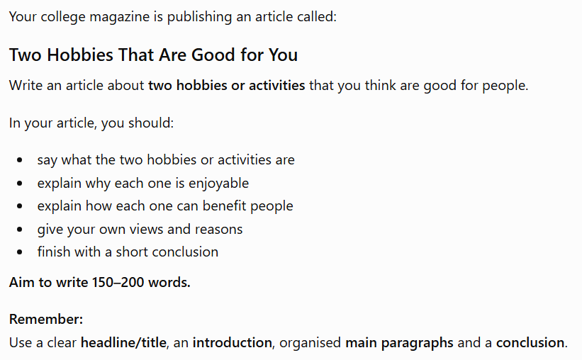
ARTICLE WRITING – Class Practice

Slide 12
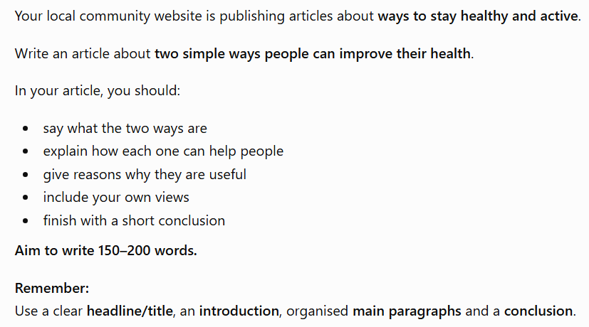
Homework – Article Writing

