Slide 1
Topic: 1
Understanding the UK Education System
Keeping Up With The Children
Helping Parents Support Their Child’s Learning

Slide 2

WARM-UP
School Word Hunt
Task:
In pairs, write down as many words as you know about school in 2 minutes!
(Example prompts: teacher, homework, uniform...)

Slide 3
Why is it Important to understand the UK Education System?
Helping your child succeed at school
Understanding school stages and terms
Communicating with teachers
Supporting homework and learning at home

Slide 4
The Structure of the UK Education System
Early Years (Age 0-5)
Primary School (Age 5-11)
Secondary School (Age 11-16)
Post-16 Education (College, Apprenticeships)

Slide 5
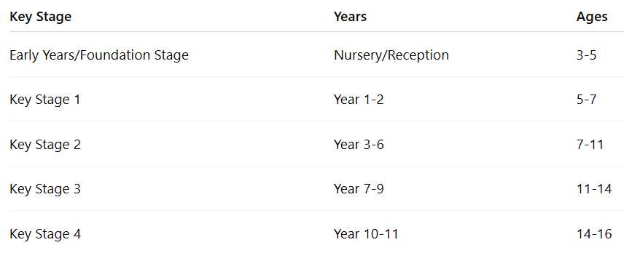
Key Stages and Year Groups

Slide 6
Types of Schools
State Schools (Free, funded by government)
Private/Independent Schools (Fee-paying)
Faith Schools (Religious affiliation)
Academies and Free Schools (State-funded
but run independently)

Slide 7

Pair Discussion
Question 1: What type of school does your child attend?
Question 2: What Key Stage is your child in?
Question 3: What school experience is different here compared to your home country?

Slide 8
How to Choose a School
Location and transport
School reputation and Ofsted reports
School visits and open days
Admissions process and deadlines

Slide 9
Who Works at School?
Headteacher / Principal
Teachers
Teaching assistants
Office staff
School nurse/counsellor

Slide 10
How Schools Communicate with Parents
Letters and newsletters
Parent-teacher meetings
Online portals and apps (e.g., ClassDojo,
ParentMail)
Text messages and phone calls

Slide 11
How Can You Support Your Child?
Attend parent meetings
Check homework and reading
Encourage daily routines
Talk about school and learning

Slide 12

Group Discussion
Topic: "Why is it important to understand the UK education system as a parent?"
(brainstorm benefits and challenges.)

Slide 13
Questions & Discussion
What questions do you have about schools?
Share your experiences with your child’s school.

Slide 14

Homework
Visit your local area or use the internet
to find three types of schools.
Write down the school names and
what type of school they are.

