Slide 1
Topic: 5
Parent-School Communication & Support
Keeping Up With The Children
Helping parents understand how to stay in touch with the school and support their child’s learning.

Slide 2
Session Objectives
By the end of this session, you will:
Understand why communication with school is important
Learn how to contact the school and ask questions
Explore different ways schools support parents
Practise speaking with teachers confidently

Slide 3

Warm-Up Game – School Word Chain
▶ Learners sit in a circle. One says a school-related word (e.g., teacher).
▶ The next learner says a word starting with the last letter (e.g., register).
▶ Continue the chain: Teacher → Register → Reading → Games → School...
Builds vocabulary and group confidence!

Slide 4
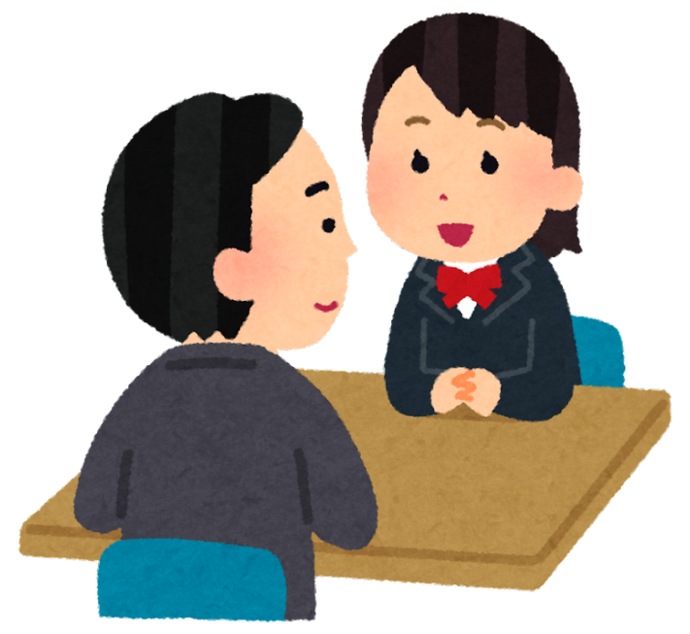
Pair Discussion
When do you talk to your child’s school?
🔹 Have you ever had a meeting with a teacher?
🔹 What did you talk about?
🔹 How did you feel?
Share with your partner.

Slide 5
Why is Parent-School Communication Important?
Understand your child’s progress
Work together to solve problems
Help your child feel supported
Join school events and activities
Ask for help when needed

Slide 6
Ways to Communicate with the School
📞 Phone calls
📧 Emails
📱 School apps or Class Dojo
📅 Parent-teacher meetings
✉️ Letters/notices
👋 Speaking at drop-off/pick-up

Slide 7
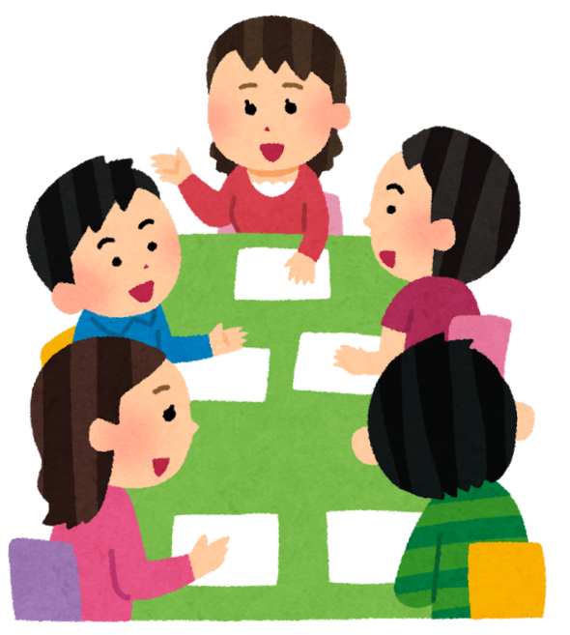
Group Discussion
What Support Have You Received?
Talk in groups:
🔹 Have you received support from school (e.g., uniform help, language support)?
🔹 What was helpful?
🔹 What would you like more of?

Slide 8
Common Questions to Ask the Teacher
“How is my child doing in reading/ writing/ /maths? ”
“Is my child behaving well?”
“How can I help at home?”
“Can I speak to you if I’m worried?”

Slide 9
Practising a Conversation
Role-play: One parent, one teacher
Topic ideas:
Your child is not finishing homework
Your child is shy in class
You want to know your child’s reading level
➡ Swap roles!

Slide 10
Key Tips for Parents
✔ Don’t wait for a problem – stay in touch
✔ Keep calm and polite when speaking to the school
✔ Use an interpreter if needed
✔ Ask questions – it shows you care
✔ Attend parents’ evenings and workshops

Slide 11
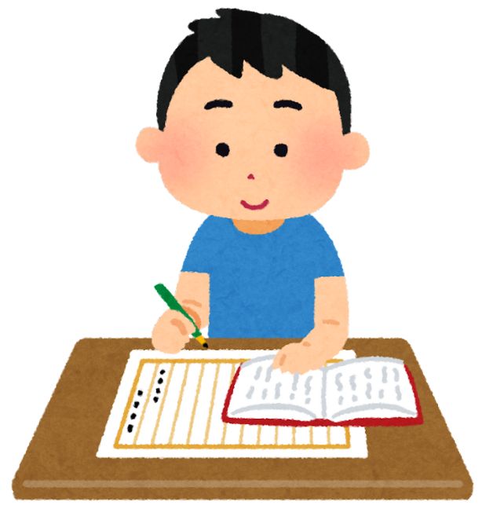
Homework
Practise writing an email or message to a teacher (real or imaginary)
Talk to your child about school: “What did you learn today?”

