Slide 1
Topic: 4
Maths and Homework Help
Keeping Up With The Children
Helping your child build confidence with numbers.

Slide 2
Session Objectives
By the end of this session, you will:
Understand how maths is taught in primary school
Learn simple ways to help your child with maths homework
Explore fun activities to support learning at home

Slide 3

Warm-Up Game – Number Talk
Game: "How Many Can You Name?"
In 1 minute, write or say as many things related to numbers as you can (e.g. 1p coin, clock, price tag, bus number).
Share with a partner.

Slide 4
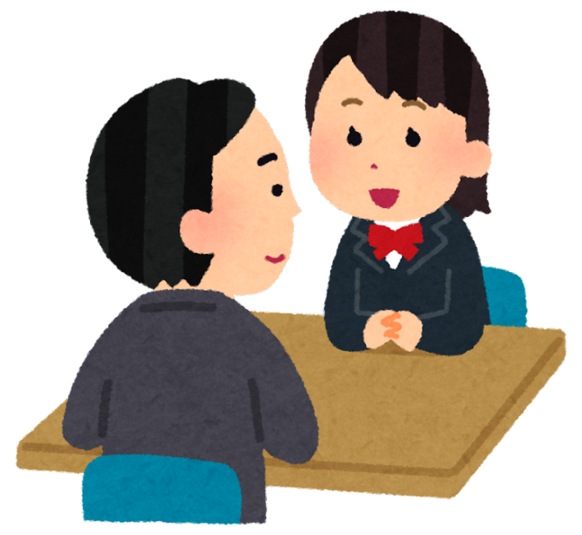
Pair Discussion
Why is Maths Important?
Why is learning maths important for children?
What maths do you use in everyday life?

Slide 5
Key Maths Topics in Primary School
Counting and number recognition
Adding and subtracting
Multiplying and dividing
Shapes and space
Measurements (length, weight, time, money)
Problem solving

Slide 6
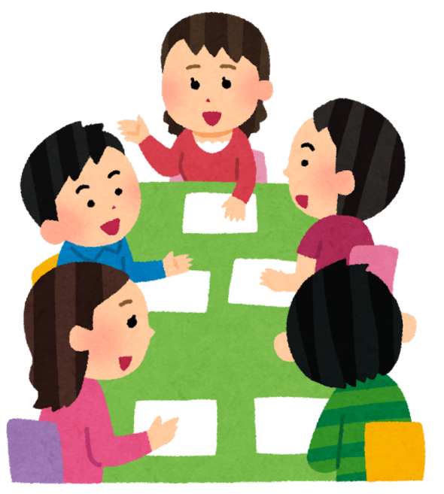
Group Discussion
Group Activity – Common Problems
What do your children find difficult in maths?
How do you help them?
What works, what doesn’t?
✔ Write ideas on a flipchart or board.

Slide 7
Practical Tips for Homework
Top Tips for Parents:
Create a calm homework space
Let your child explain the question
Use fingers, counters or real objects
Don’t do the work for them — guide them
Keep sessions short and positive

Slide 8
How to Help at Home
Talk about numbers during daily routines
Use everyday objects (money, food, clocks)
Play games with numbers and counting
Practise times tables with songs and apps
Praise effort, not just correct answers

Slide 9
Helpful Resources
Maths apps and websites:
Topmarks
BBC Bitesize
Hit the Button
Times Table Rock Stars
Ask the school for workbooks or guidance

Slide 10
Reflection and Feedback
What new ideas did you learn today?
How will you use them at home?
Fill in a quick feedback sheet or discuss as a group.

Slide 11
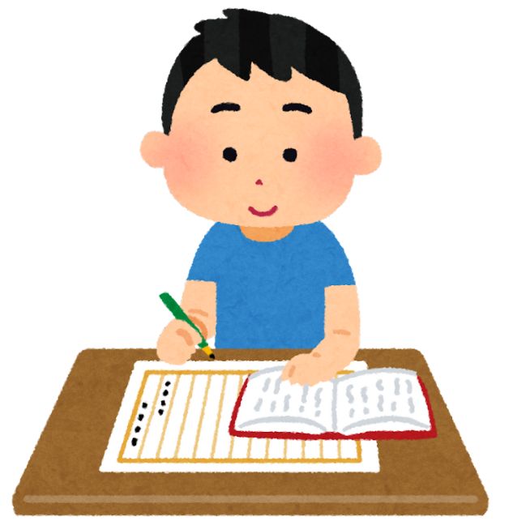
Homework
Task 1:
Talk to your child about money.
🔹 Ask: “How much does this cost?”
🔹 Let them count coins and notes.
Task 2:
Play a maths game at home.
🔹 Ideas: Dominoes, Dice Games, Snakes and Ladders, Number Card Games.
Task 3:
Practise times tables or counting:
🔹 Count steps, stairs, fruit, cars… anything!
Optional:
Visit www.topmarks.co.uk and play a number game together.

