Slide 1
Topic: 3
Supporting Writing and Spelling at Home
Keeping Up With The Children
Helping Your Child Become a Confident Writer

Slide 2
Session Aims
Understand how children learn to write and spell
Learn fun and easy ways to help at home
Explore writing activities for daily routines
Share ideas with other parents

Slide 3

Warm-Up Game – "Word Chain"
Instructions:
Sit in a circle or pairs.
One person says a simple word (e.g., "cat").
The next person says a word that starts with the last letter ("t" → "top").
Continue the chain.
Purpose: Builds vocabulary, sounds, and spelling awareness.

Slide 4
How Children Learn to Write
Start with marks, scribbles, then letters
Copy letters and names
Short words using sounds they know (phonics)
Practice makes progress, not perfection!

Slide 5
Supporting Spelling with Phonics
Use sound-letter matching: e.g., s-a-t, p-i-n, m-a-n
Break words into sounds (segmenting)
Use visual memory (look, say, cover, write, check)
Rhyming helps: cat, hat, mat

Slide 6
Writing Ideas at Home
Shopping lists
Birthday cards
Labels on drawers
Short messages or notes
Captions for pictures
Writing names on artwork

Slide 7
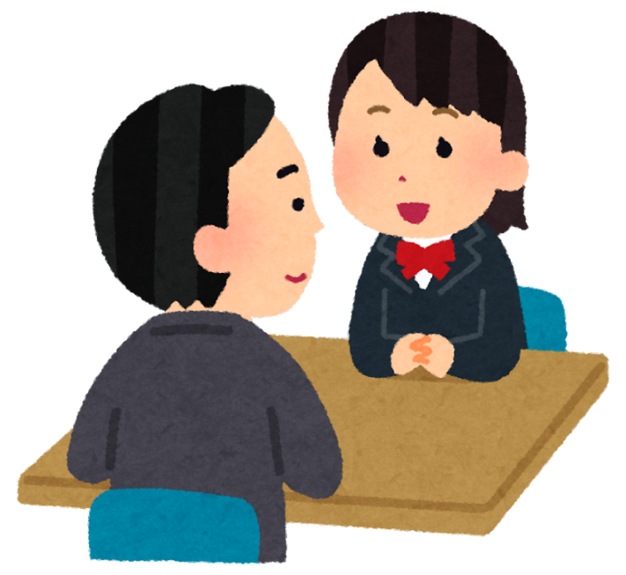
Pair Discussion
Prompt:
“What writing activities do you already do with your child at home?”
Write shopping lists?
Label pictures?
Write names or cards?
Instructions:
Talk to your partner for 3 minutes and write down 2 ideas.

Slide 8
Fun Spelling Activities
Word hunt: Find objects that start with "b"
Fridge letters: Make new words
Trace in sand or flour
Magnetic letters spelling
Simple spelling games (e.g., "missing letter")

Slide 9
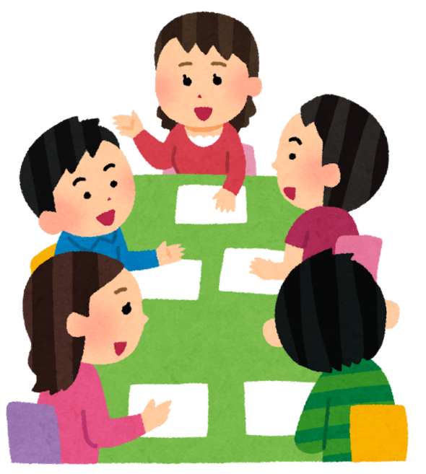
Group Discussion
Question:
💬 “Why do children find spelling difficult? How can we make it easier?”
Discuss as a class.
Tutor records answers on the board.
Examples: confusing sounds, silent letters, lack of confidence, irregular spellings

Slide 10
Helping Without Pressure
Praise effort, not just correctness
Let them write freely sometimes
Use gentle correction: “Let’s try that again together.”
Give space and tools (paper, pencils, whiteboards)

Slide 11
Quick Tips for Parents
Use simple, everyday tasks
Write with your child
Say the sounds slowly when spelling
Keep it fun and short

Slide 12
Summary
Writing takes time and practice
Support with sounds and spelling
Use daily life to build skills
Encourage and celebrate writing

Slide 13
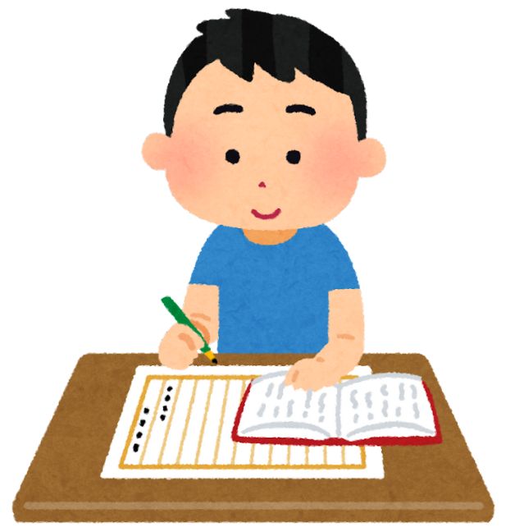
Homework
Task for Parents:
📝 Ask your child to help write a simple shopping list or a note to a friend.
✔ Let them sound out the words
✔ Take a photo or bring the list to the next class!

