Slide 1
Topic: 2
Jobs and Workplaces
ESOL FOR JOB SEEKERS
Talking about different jobs and where people work

Slide 2
Session Objectives
By the end of this session, you will:
Learn vocabulary for common jobs and workplaces
Practise saying where people work
Use simple sentences to describe job duties
Practise speaking in pairs and groups

Slide 3

Warm-Up Game – "Job Charades"
Instructions:
  One student comes to the front.
  Teacher whispers or shows a job card.
  Student acts it out (no speaking).
  Class guesses: “Are you a…?”
🧠 Purpose: Activate job vocabulary in a fun way.

Slide 4
Vocabulary – Jobs
Show pictures with labels:
  Teacher, Nurse, Cleaner, Driver, Waiter, Shop Assistant, Builder, Chef, Factory Worker, Security Guard
Say the word and ask learners to repeat
Drill pronunciation and stress
Link for the flashcards:
https://www.esolish.com/wp-content/uploads/2025/05/Professions.pdf

Slide 5
Vocabulary – Workplaces
Match the jobs to workplaces:
  Hospital, School, Restaurant, Factory, Shop, Building Site, Office
Example: A teacher works in a school.

Slide 6
Pair Work – “Who Works Where?”
Instructions:
  Each pair gets 6 job cards and 6 workplace cards.
  Match them and say the sentence:
    “A ___ works in a ___."
Extension: Ask and answer:
  “Where does a ___ work?”
  “A ___ works in a ___.”

Slide 7
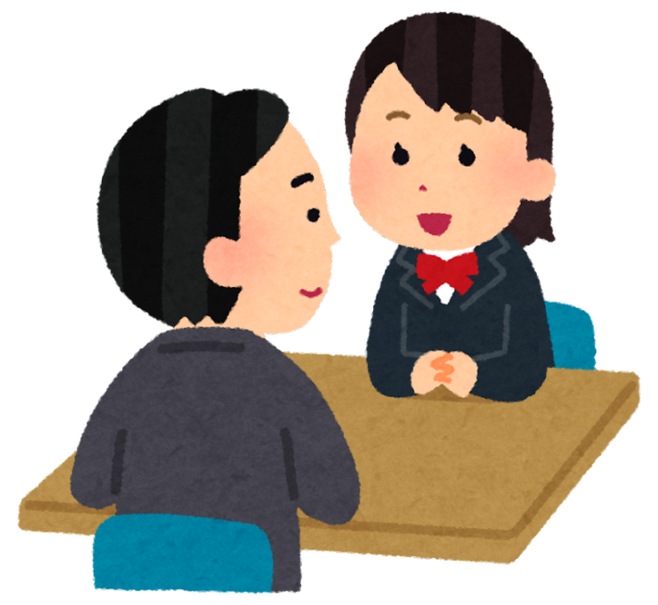
Pair Discussion
“Jobs in My Family”
Learners ask and answer:
  “What job does your husband/wife/brother do?”
  “Where does he/she work?”
Share 1 answer with the class.
Sentence starters:
  “My husband is a ___. He works in a ___.”

Slide 8
Speaking Practice – What Do They Do?
Show 4 job pictures in action (e.g. chef cooking).
Ask: “What does a chef do?”
Model answers: “A chef cooks food.”
Pairs practise describing job duties.

Slide 9
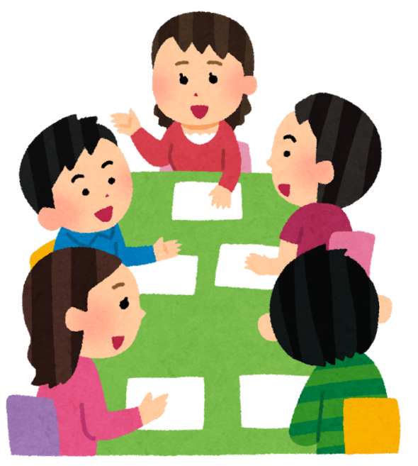
Group Discussion
"Which Job Is Best?"
Discussion questions:
  “Which job is good for men or women?”
  “Which job is easy/difficult?”
  “What job do you want and why?”
Sentence frames:
  “I think a ___ is a good job because…”
  “I don’t want to be a ___ because…”

Slide 10
Writing – My Dream Job
Learners write a few sentences:
  “I want to be a ___. I want to work in a ___. I can ___.”
Share with partner or read aloud to class.

Slide 11
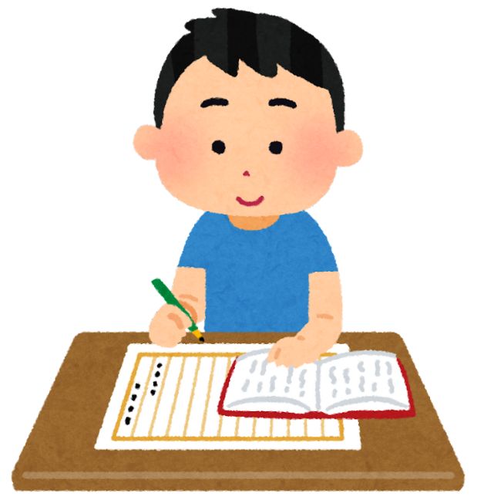
Homework
Interview two friends or family members:
  What is your job?
  Where do you work?
  What do you do?
Write 3–5 simple sentences to share next class.

Slide 12
Review & Exit Ticket
Ask learners:
  Name 3 jobs and 3 workplaces
  Say one full sentence: “A ___ works in a ___.”
Exit question: “What job do you want?”

