Slide 1
ESOL FOR JOB SEEKERS
Topic: 1
Introduction & Personal Information
Learn how to say your name, age, address, and phone number

Slide 2

WARM-UP
"Name and Action"
Stand up and say your name with an action (e.g., "My name is Sarah" + wave).
Everyone repeats the name and action.
Purpose: Practice names and have fun!

Slide 3
Useful Questions
What is your name?
How old are you?
Where do you live?
What is your phone number?

Slide 4
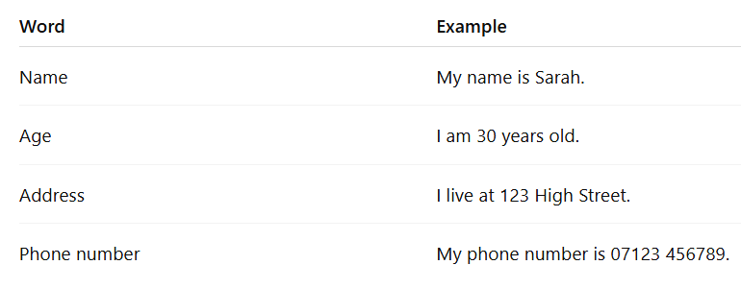
Personal Information Vocabulary

Slide 5
Spelling Your Name
Can you spell your name?
Example: S - A - R - A - H
Practice spelling with your partner.

Slide 6

Pair Discussion
Interview Your Partner
Ask your partner:
What is your name?
How old are you?
Where do you live?
What is your phone number?
Write down their answers.

Slide 7
Form Filling Practice
Look at this form
(form provided in the handouts section on the website)
How do you fill it out?
Let’s do it together!

Slide 8
WORKSHEET
IT’S TIME TO PRACTICE WHAT WE HAVE LEARNT.
(worksheet provided in the worksheet section on the website)

Slide 9

Group Discussion
Where Are We From?
Share with the group where you live and one interesting thing about your area or country.
Listen to others and ask questions.

Slide 10
Summary
Today, we learned how to:
  Give personal information.
  Spell names.
  Fill in a basic form.

Slide 11

Homework
Practice spelling your name and writing your address.
Practice asking and answering these questions with a family member or friend:
  What is your name?
  How old are you?
  Where do you live?
  What is your phone number?

