Slide 1
Topic: 7
Learning at Home & Fun Engagement Strategies
Keeping Up With The Children
Discover easy ways to help your child learn and have fun at home!

Slide 2
Session Objectives
By the end of this session, participants will be able to:
Understand the importance of learning at home.
Identify everyday household activities that support learning.
Explore fun and creative strategies to engage children in learning.
Share and reflect on personal experiences of supporting learning at home.
Plan and try at least one fun learning activity with their child.

Slide 3

Warm-Up Game – "Learning Happens Everywhere!"
Question for Group Sharing:
Where do your children learn outside of school?
Examples: kitchen, bus stop, shops, garden
🗣 Pair and share 2–3 ideas with your partner.

Slide 4
Why Learning at Home Matters
Builds confidence and routine
Strengthens parent-child bond
Improves school performance
Helps children see learning as fun

Slide 5
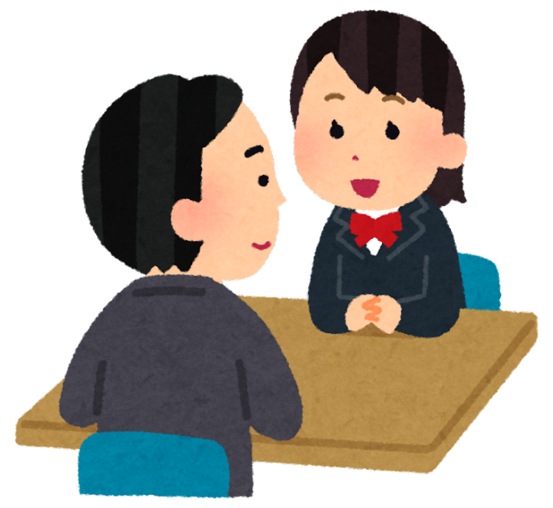
Pair Discussion
What Works for You?
Discuss with a partner:
What do you already do at home to support learning?
What new idea will you try this week?

Slide 6
Simple Learning at Home Ideas
🧺 Laundry: Sort by colour, size, count socks
🛒 Grocery list: Read/write, budget, count
🕒 Cooking: Measure, follow steps, time
🎲 Board games: Turn-taking, rules, numbers
📚 Storytime: Ask questions, retell, phonics

Slide 7
Fun Engagement Strategies
🎨 Art: Draw letters, shapes, or stories
🎵 Music: Sing rhymes, spell words through songs
🏠 Role play: Shopkeeper, teacher, doctor
🧩 Puzzles: Matching shapes, letters, numbers
🎯 Flashcard games, memory matching, scavenger hunts

Slide 8
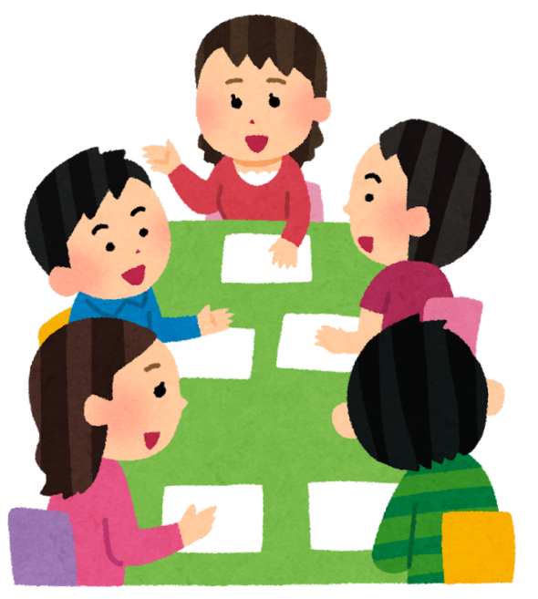
Group Discussion
Create a Fun Learning Game
In groups, choose a home setting (kitchen, shop, park).
Create a short learning game idea using simple objects.
💡 Share your game with the class!

Slide 9
How to Keep It Going
Be patient and playful
Celebrate small successes
Use praise and encouragement
Set a short daily routine (10–15 minutes)
Keep learning visible (charts, fridge notes, labels)

Slide 10
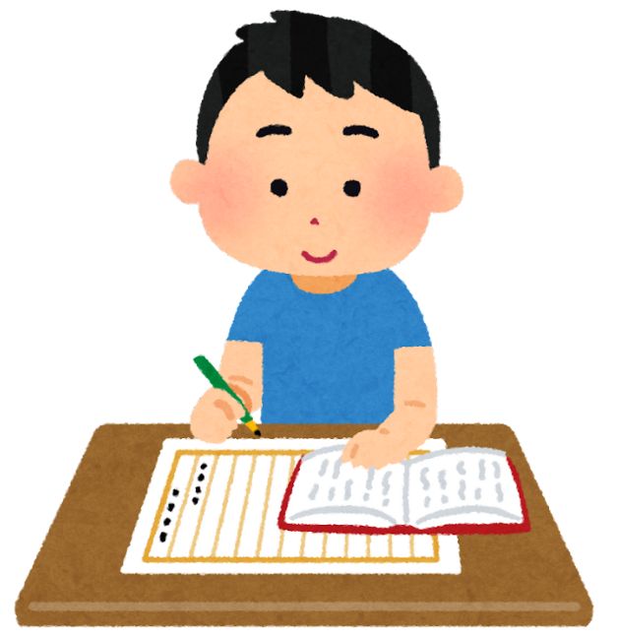
Homework
✔ Try one fun learning activity with your child (e.g., matching socks, spelling with food labels)
✔ Ask your child what they enjoyed most
✔ Write 2–3 sentences about your experience to share next session.

