Slide 1
Topic: 2
Supporting Reading and Phonics at Home
Keeping Up With The Children
Helping your child enjoy reading and build strong phonics skills

Slide 2
Session Objectives
By the end of this session, you will:
Understand what phonics is and why it matters
Learn how reading is taught in UK schools
Explore fun ways to support reading at home
Share experiences with other parents

Slide 3

Warm-Up Game – Sound Hunt
Instructions:
🔊 Say a sound (e.g. /s/)
👀 Ask parents to look around and find an item that starts with that sound
🎤 Say the word aloud together
Example Sounds:
/s/, /m/, /b/, /t/
(Repeat 3–4 times with different sounds)

Slide 4
What is Phonics?
A way of teaching children to read using sounds (phonemes)
Children learn the sounds that letters and groups of letters make
They blend sounds to read words (e.g., c-a-t → cat)
📘 Schools often use schemes like Letters and Sounds, Read Write Inc., or Jolly Phonics

Slide 5
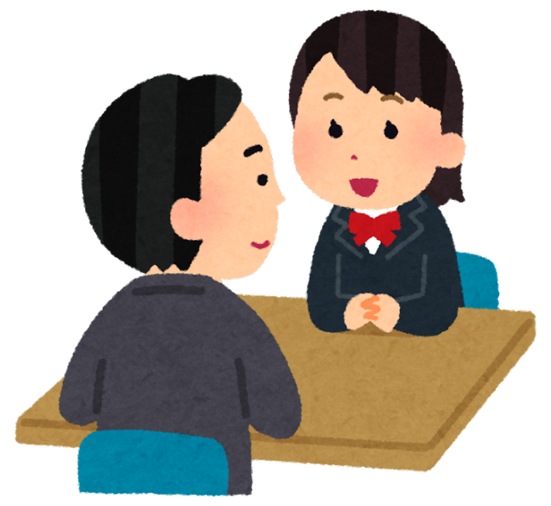
Pair Discussion
Reading at Home
Talk to your partner:
Do you read with your child at home?
What kind of books do you read together?
What do you find easy or difficult?
(Take 3–5 minutes to discuss, then share with the group)

Slide 6
How Schools Teach Reading
Daily phonics sessions
Group reading (guided reading)
Individual reading books (home readers)
Phonics assessments (e.g., Year 1 Phonics Screening Check)
Parents are encouraged to read daily at home with their child

Slide 7
How Can I Help at Home?
📖 Read with your child every day – even 5–10 minutes helps
👂 Say letter sounds, not letter names
🗣️ Play sound games (I spy, rhyming, sound matching)
🔤 Use phonics flashcards or apps
🎵 Sing songs and nursery rhymes
📚 Visit the library together

Slide 8
Home Reading Tips
Let your child choose books they enjoy
Point to words as you read
Ask questions: “What do you think will happen next?”
Praise effort, not just correctness
Re-read favourite books

Slide 9
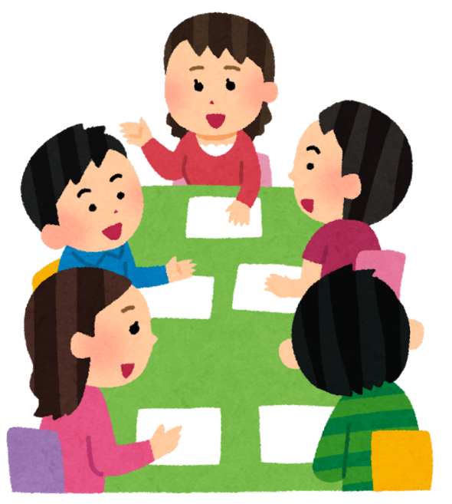
Group Discussion
Why Phonics?
In small groups, discuss:
Why is phonics important for children learning to read?
Did you learn to read this way?
What helps children remember sounds?
(Write ideas on a flip chart if needed)

Slide 10
Pair Work – Try a Phonics Activity
In pairs, try this:
Say and blend the sounds: s-a-t, m-a-n, p-i-g
Break a word into sounds and ask your partner to guess it
Try the game: “I say the sound, you say the word!”
📢 Share one idea you might try at home

Slide 11
Useful Resources for Parents
PhonicsPlay.co.uk – Free games
BBC Bitesize Phonics
Library books with sound buttons or simple texts
School reading book scheme

Slide 12
Reflection & Takeaway
What is one thing you learned today?
What will you try at home this week?
Write on a sticky note or share with the group.

Slide 13
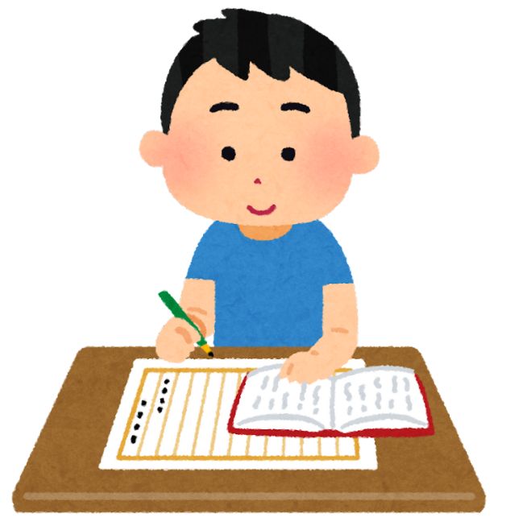
Homework
Instructions for Parents:
This week, please try the following tasks at home with your child:
Read a Book Together
  Choose a simple book your child enjoys.
  Read aloud and let your child join in with familiar words.
Sound Hunt at Home
  Choose a sound (e.g., /s/).
  Ask your child to find 3 objects at home that start with that sound.
  Write or draw them together.

